Slide 1
Design Data Intensive Application

Slide 2
Reliable, Scalable and Maintainable Application

Slide 3
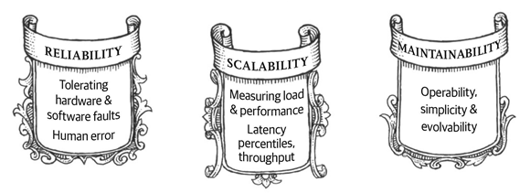
What we need for Big Data

Slide 4
Reliability
Hardware Software Fault tolerance
Instead of having expensive redundant hardware, we allow a node to fail.
Many nodes can fail in the cluster, but they may fail at different time.
Be able to detect node failure either due to HW or SW problem and bring the node down.
Human Error tolerance
Minimize opportunities for human errors
Separate non-production and production environment.
Scale unit deployment and can roll back.

Slide 5
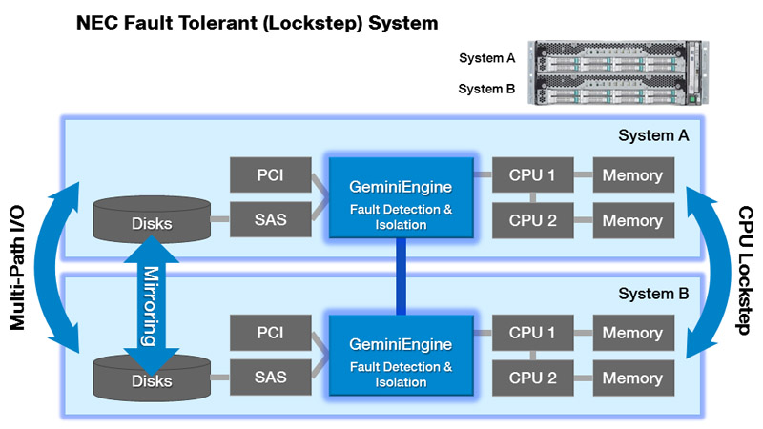

Slide 6
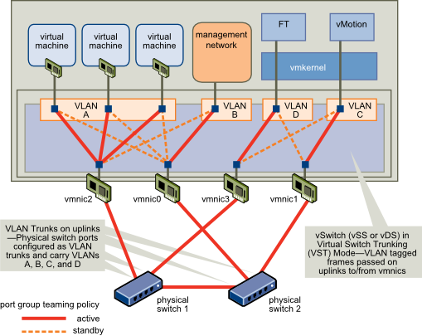
Fault Tolerant Host Network

Slide 7
Scalability
What if we add more nodes?
After increasing resource, how much impact on response time and latency for your current workload.
After increasing resource, how much improvement on throughput?
Use statistics instead of individual experience.

Slide 8
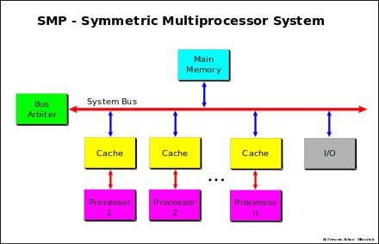

Slide 9
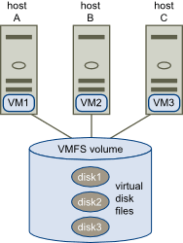
Multiple Hosts Share Disk

Slide 10
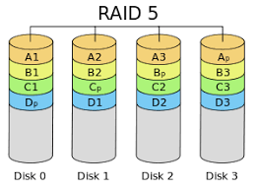

Slide 11
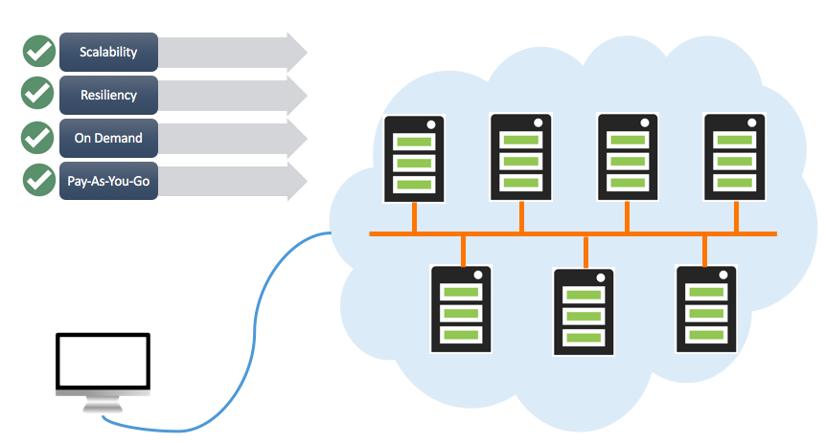
Cloud Servers

Slide 12
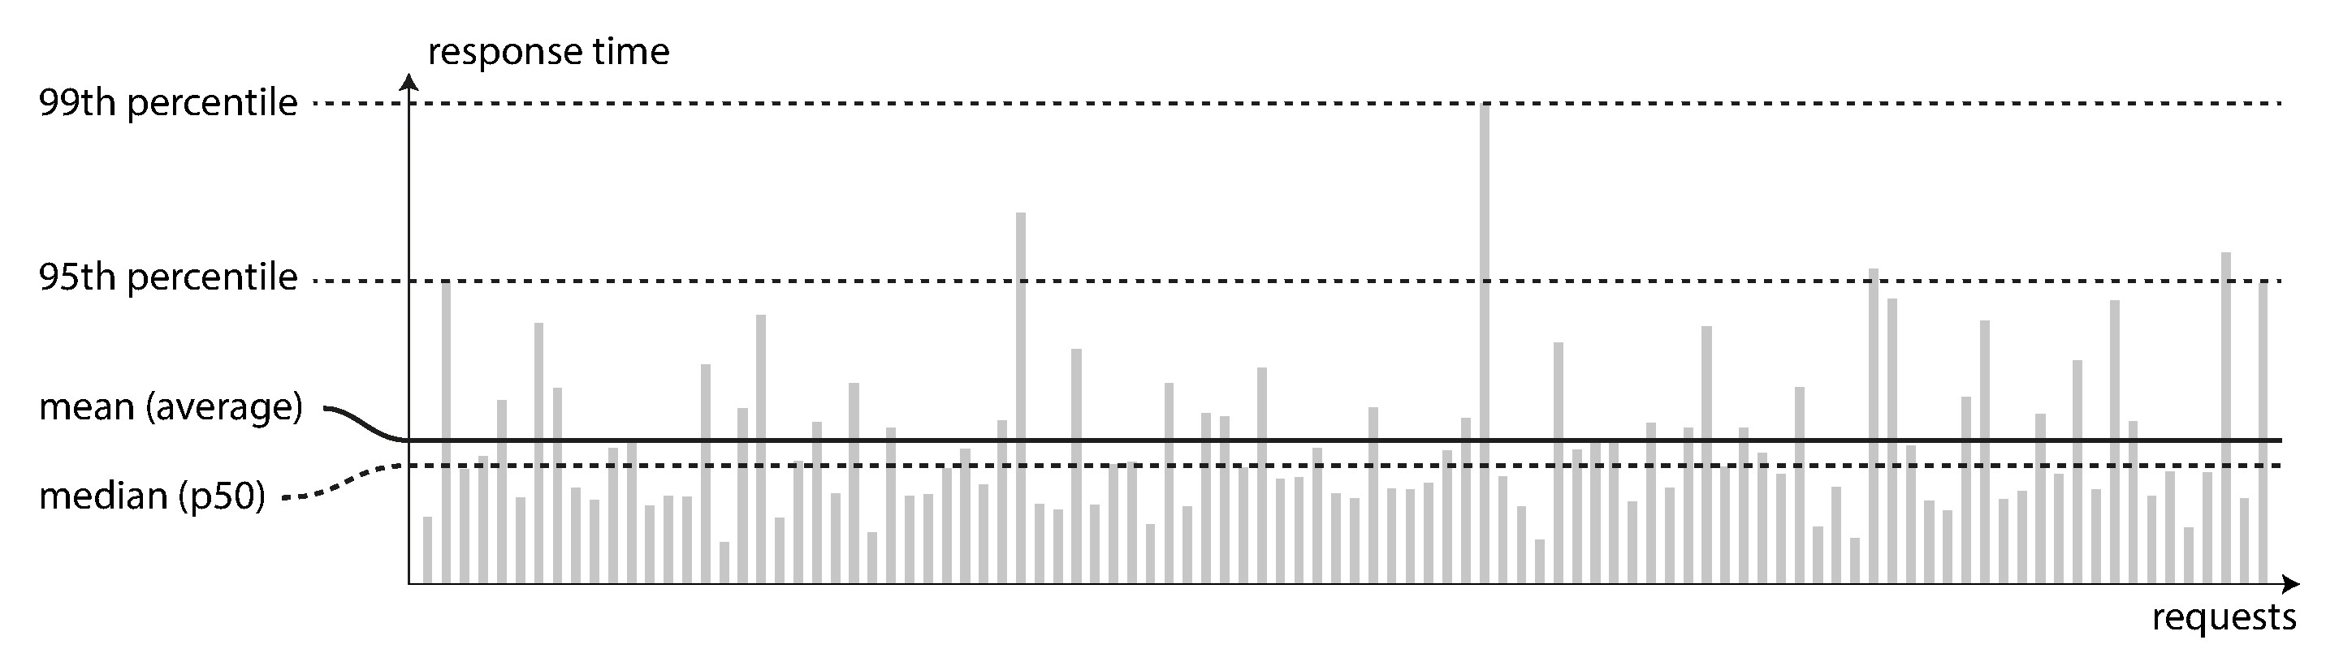
Latency and response time

Slide 13
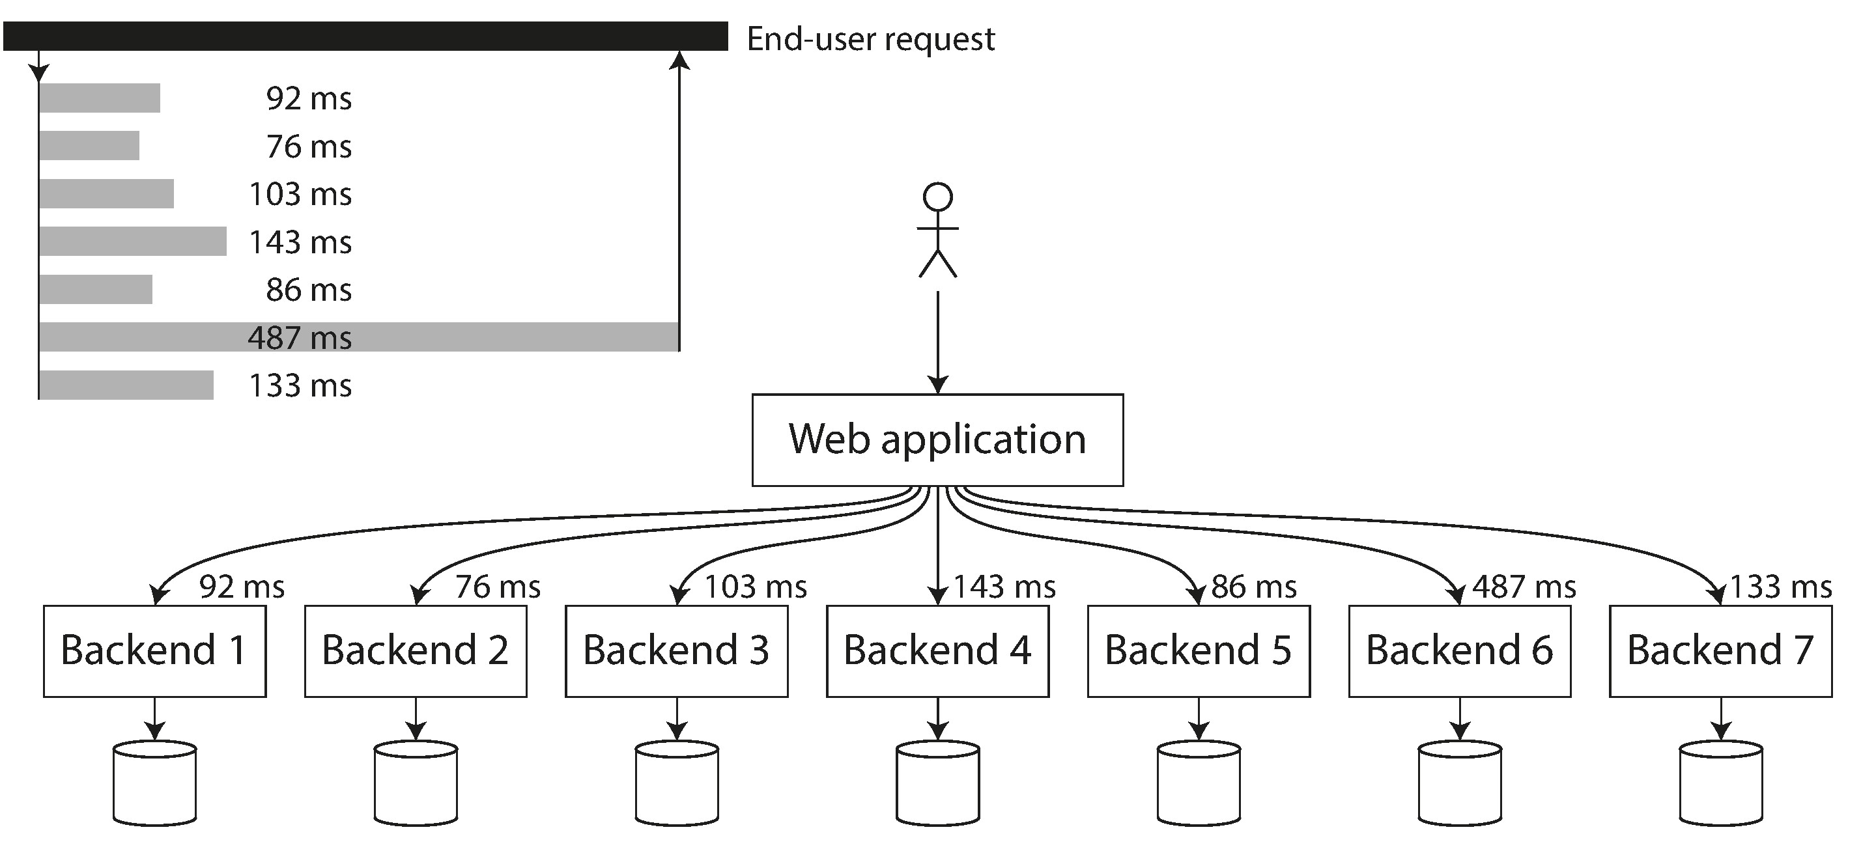
Slowest Call become the bottleneck

Slide 14
Monitoring and Troubleshooting
Monitoring the health of the system and quickly restoring service if it goes into a bad state.
Tracking down the cause of problems, such as system failures or degraded performance.
Keeping software and platforms up to date, including security patches.
Keeping tabs on how different systems affect each other, so that a problematic change can be avoided before it causes damage.
Anticipating future problems and solving them before they occur (e.g., capacity planning)
Establishing good tools for deployment, configuration management, and Performing complex maintenance tasks in an automated way by tooling.
Maintaining the security of the system as configuration changes are made

Slide 15
Maintainability
Operability
Make it easy for operations teams to keep the system running smoothly.
Simplicity
Make it easy for new engineers to understand the system, by removing as much complexity as possible from the system. (Note this is not the same as simplicity of the user interface.)
Evolvability
Make it easy for engineers to make changes to the system in the future, adapting it for unanticipated use cases as requirements change. Also known as extensibility, modifiability, or plasticity.

Slide 16
Data Models

Slide 17
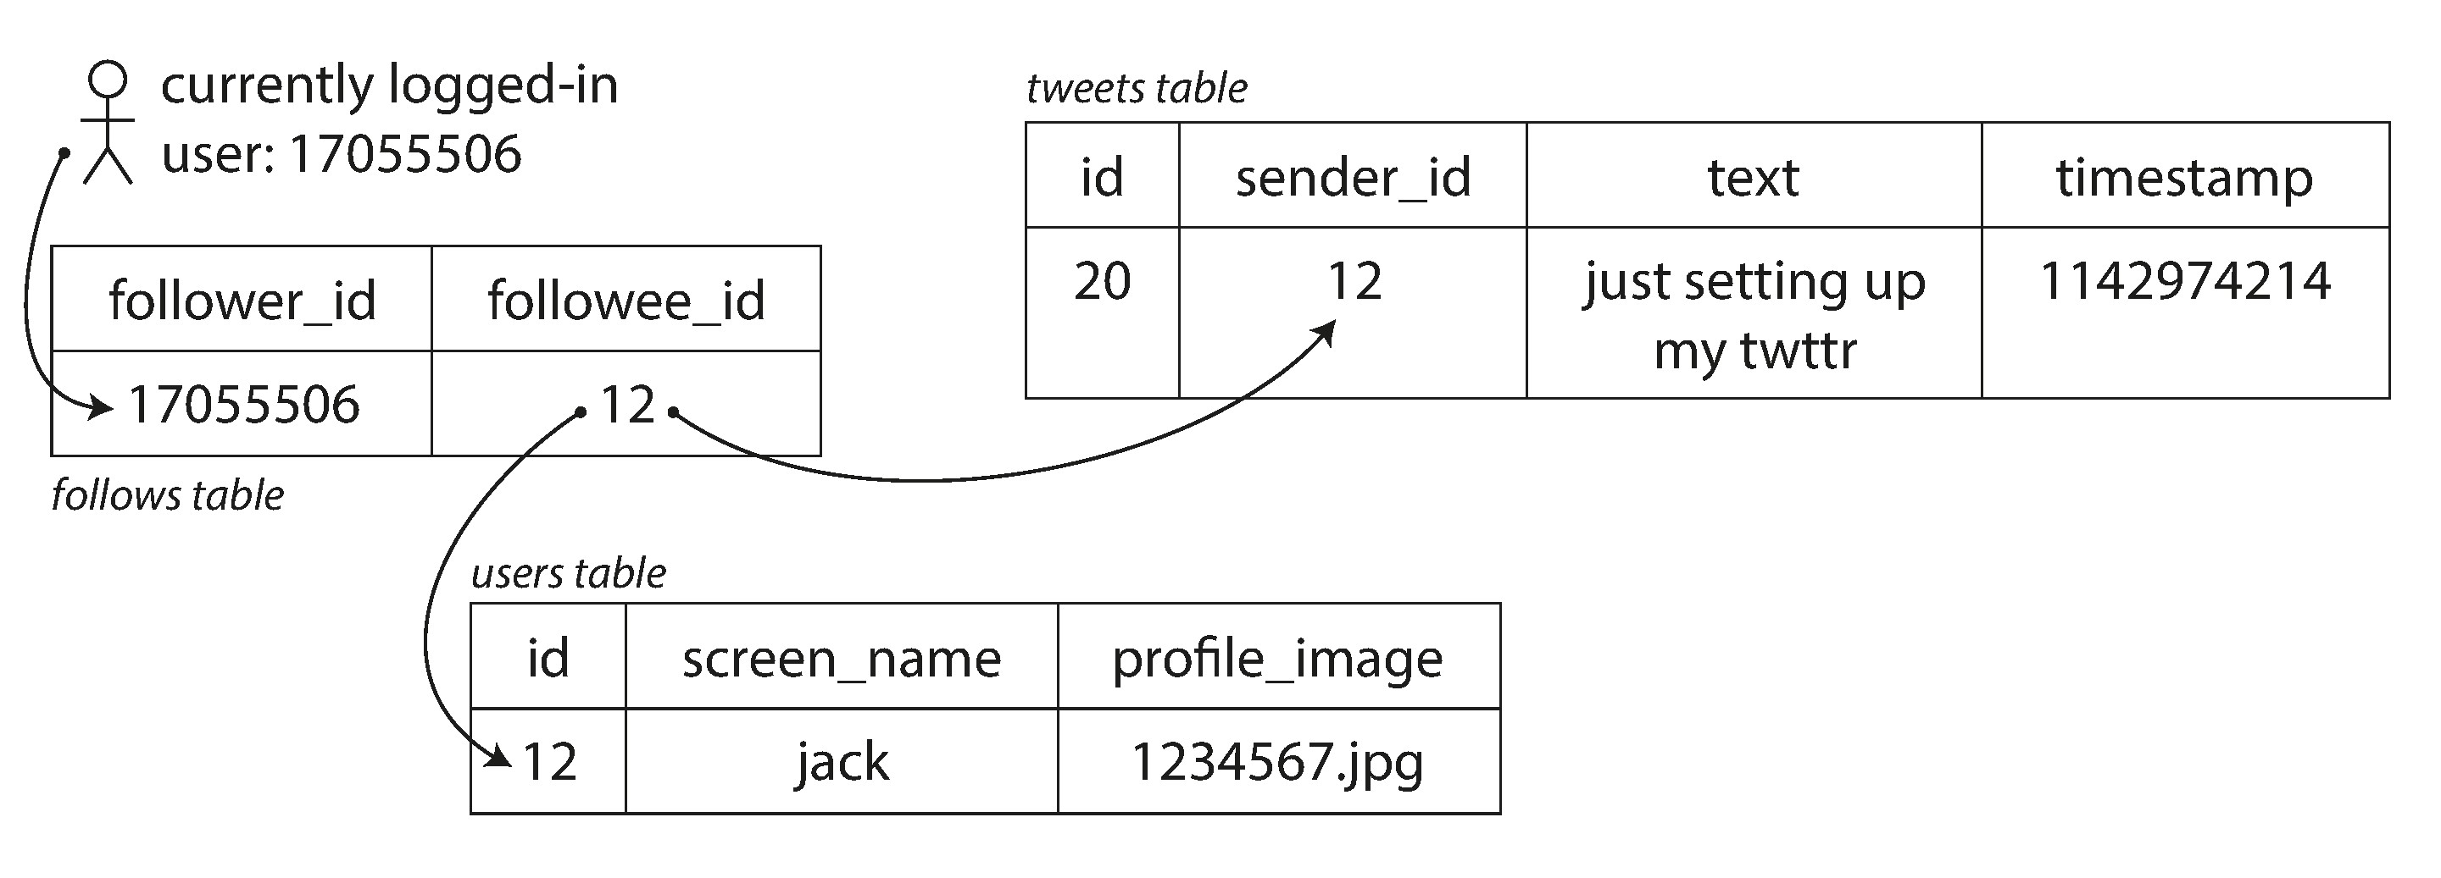
Relational Model
An example of Tweet
We need join to get the whole picture of the data.

Slide 18
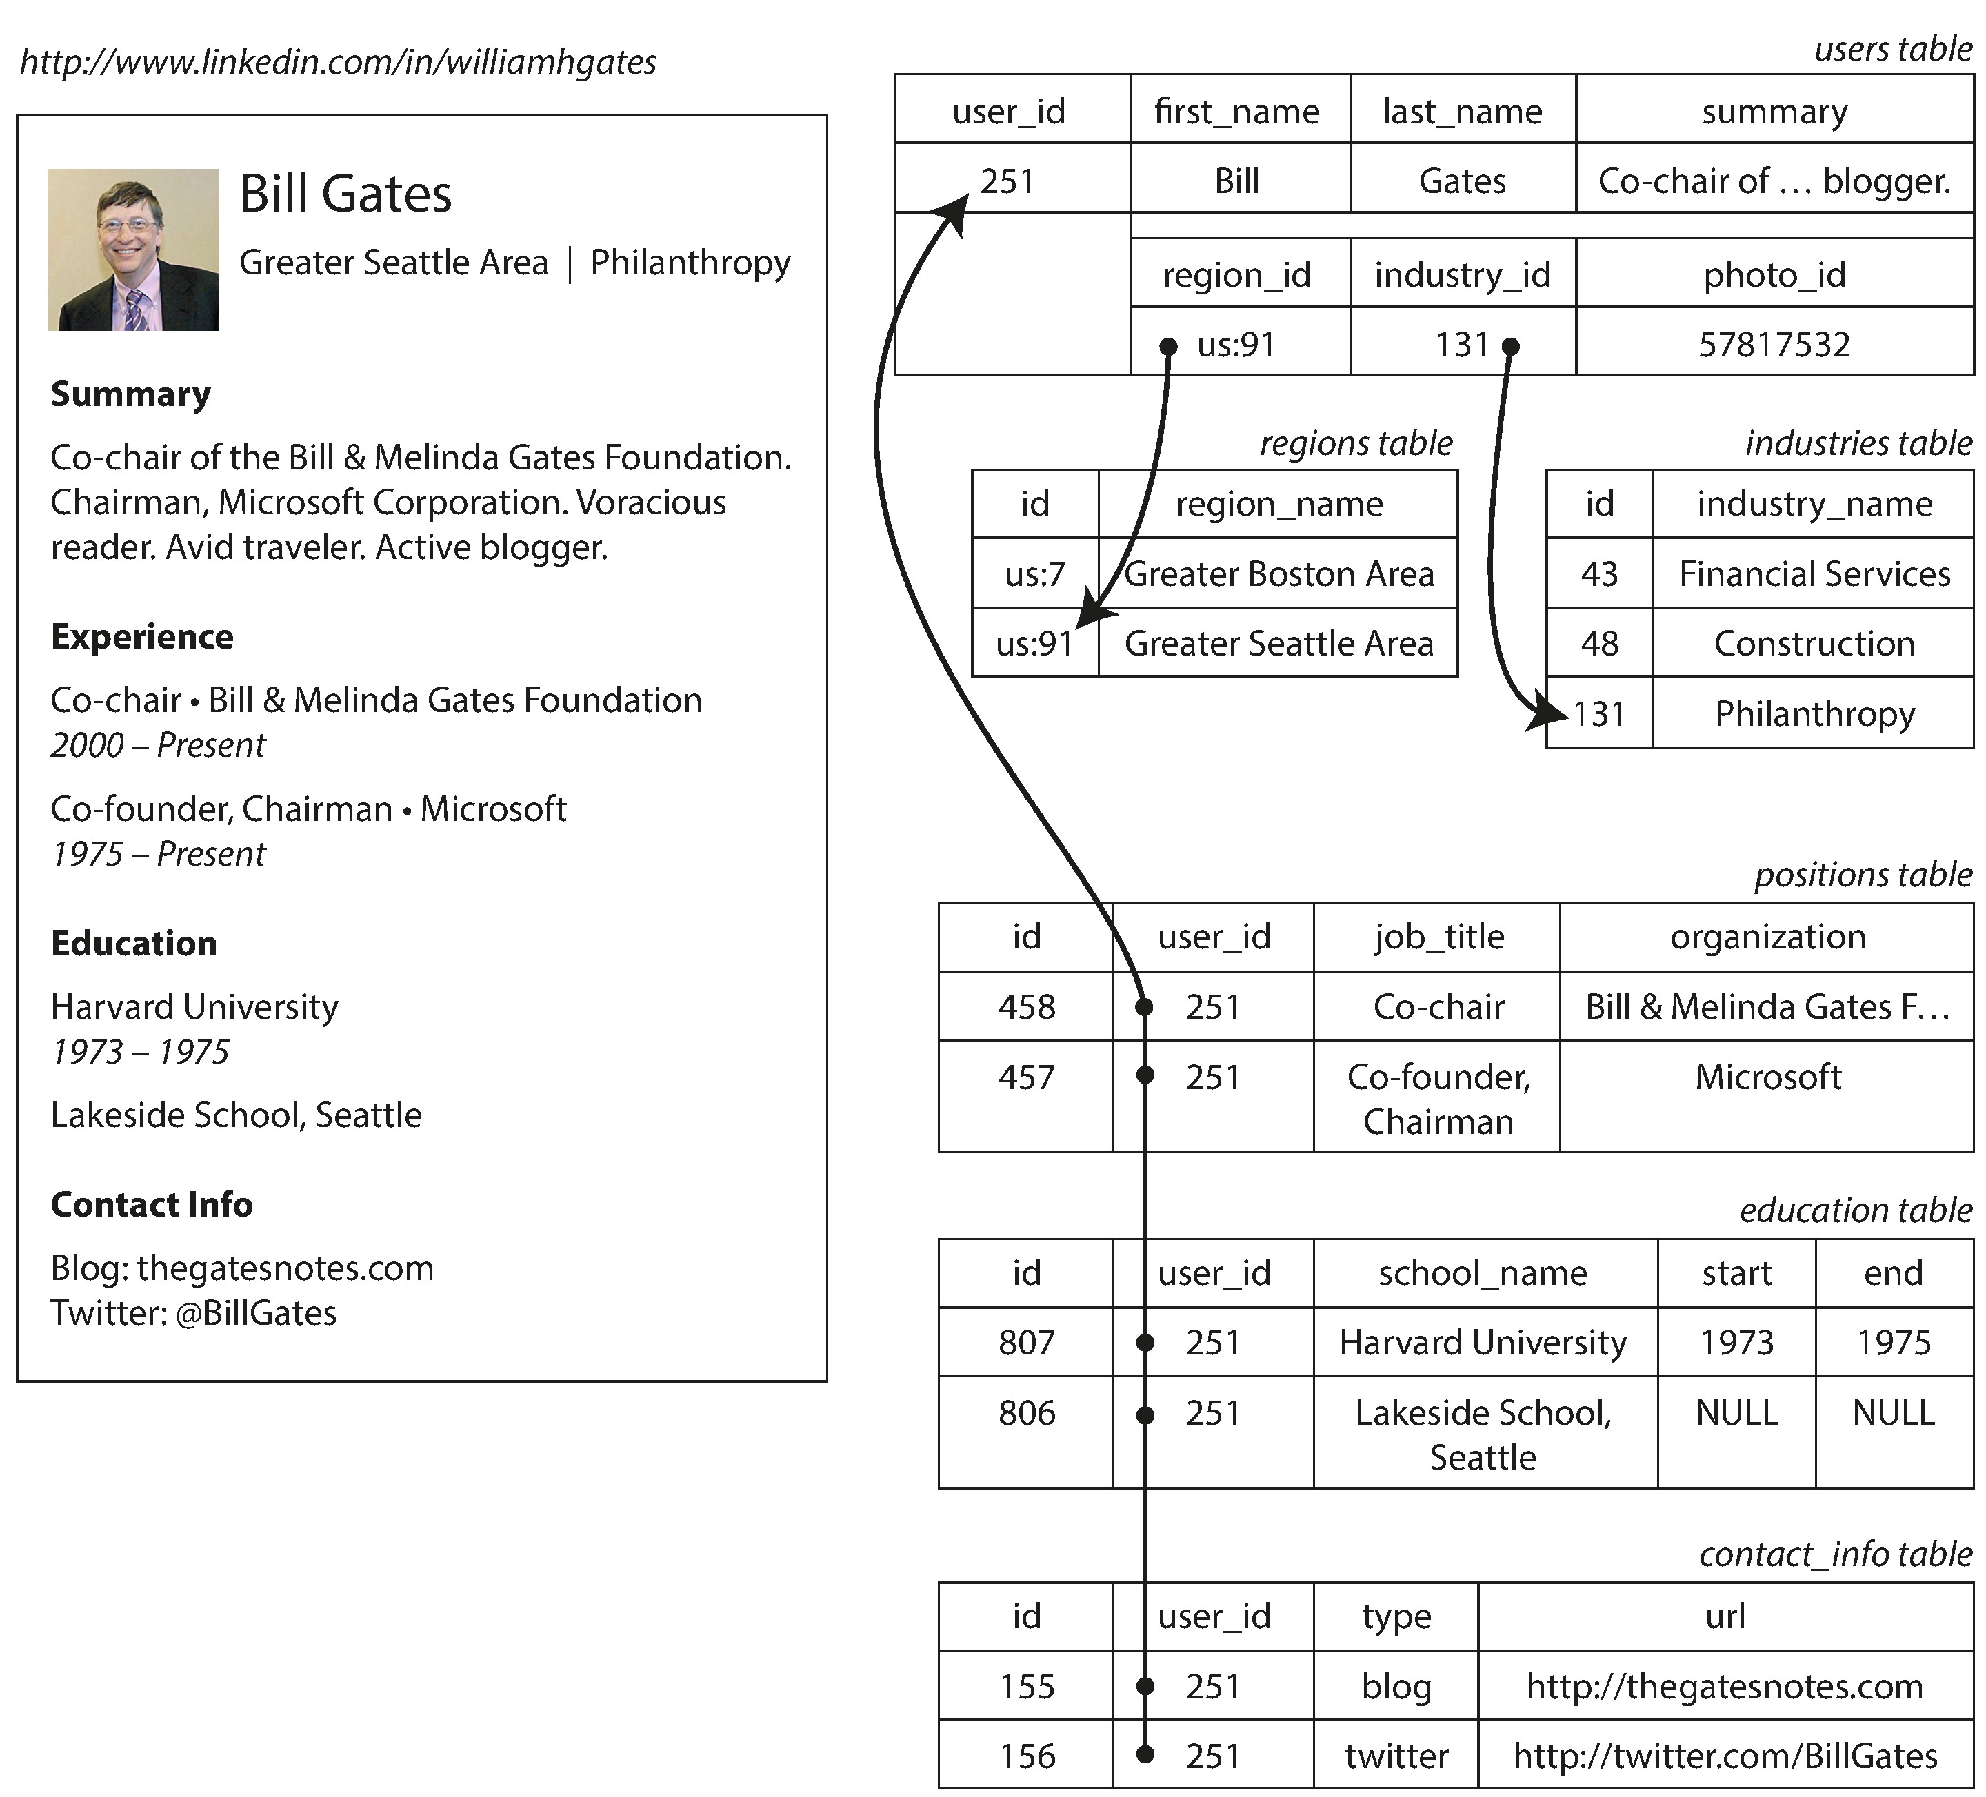
Document Model
A LinkedIn Profile

Slide 19
One-to-Many Relationships

Slide 20
Many-to-Many Relationships

Slide 21
Relational Algebra
function getSharks() {
var sharks = [];
for (var i = 0; i < animals.length; i++) {
if (animals[i].family === "Sharks") {
sharks.push(animals[i]);
}
}
return sharks;
}
sharks = σfamily = “Sharks” (animals)
SELECT * FROM animals WHERE family = 'Sharks';

Slide 22
JSON document
Example 2-1. Representing a LinkedIn profile as a JSON document
{
"user_id": 251,
"first_name": "Bill",
"last_name": "Gates", "summary": "Co-chair of the Bill & Melinda Gates... Active blogger.",
"region_id": "us:91",
"industry_id": 131,
"photo_url": "/p/7/000/253/05b/308dd6e.jpg",
"positions": [
{"job_title": "Co-chair", "organization": "Bill & Melinda Gates Foundation"},
{"job_title": "Co-founder, Chairman", "organization": "Microsoft"}
],
"education": [
{"school_name": "Harvard University", "start": 1973, "end": 1975}, {"school_name": "Lakeside School, Seattle", "start": null, "end": null}
],
"contact_info": {
"blog": "http://thegatesnotes.com",
"twitter": "http://twitter.com/BillGates"
}
}
In document model, data can be normalized as many-to-one relationships.
Schema flexible
All data are local and join is not needed.

Slide 23
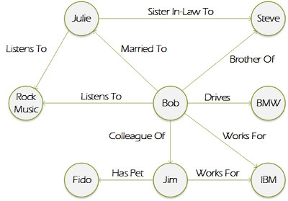
Graph Like Data Model

Slide 24
XML Query Language
var liElements = document.getElementsByTagName("li");
for (var i = 0; i < liElements.length; i++) {
if (liElements[i].className === "selected") {
var children = liElements[i].childNodes;
for (var j = 0; j < children.length; j++) {
var child = children[j];
if (child.nodeType === Node.ELEMENT_NODE && child.tagName === "P") {
child.setAttribute("style", "background-color: blue");
}
}
}
}
<xsl:template match="li[@class='selected']/p">
<fo:block background-color="blue">
<xsl:apply-templates/>
</fo:block>
</xsl:template>

Slide 25
Map Reduce Query
db.observations.mapReduce(
function map() {
var year = this.observationTimestamp.getFullYear();
var month = this.observationTimestamp.getMonth() + 1;
emit(year + "-" + month, this.numAnimals);
},
function reduce(key, values) {
return Array.sum(values);
},
{
query: { family: "Sharks" },
out: "monthlySharkReport"
}
);
The filter to consider only shark species can be specified declaratively (this is a MongoDB-specific extension to MapReduce).
The JavaScript function map is called once for every document that matches query, with this set to the document object.
The map function emits a key (a string consisting of year and month, such as "2013-12" or "2014-1") and a value (the number of animals in that observation).
The key-value pairs emitted by map are grouped by key. For all key-value pairs with the same key (i.e., the same month and year), the reduce function is called once.
The reduce function adds up the number of animals from all observations in a particular month.
The final output is written to the collection monthlySharkReport.

Slide 26
Map Reduce Query – Declarative
db.observations.aggregate([
{ $match: { family: "Sharks" } },
{ $group: {
_id: {
year: { $year: "$observationTimestamp" },
month: { $month: "$observationTimestamp" }
},
totalAnimals: { $sum: "$numAnimals" }
} }
]);

Slide 27
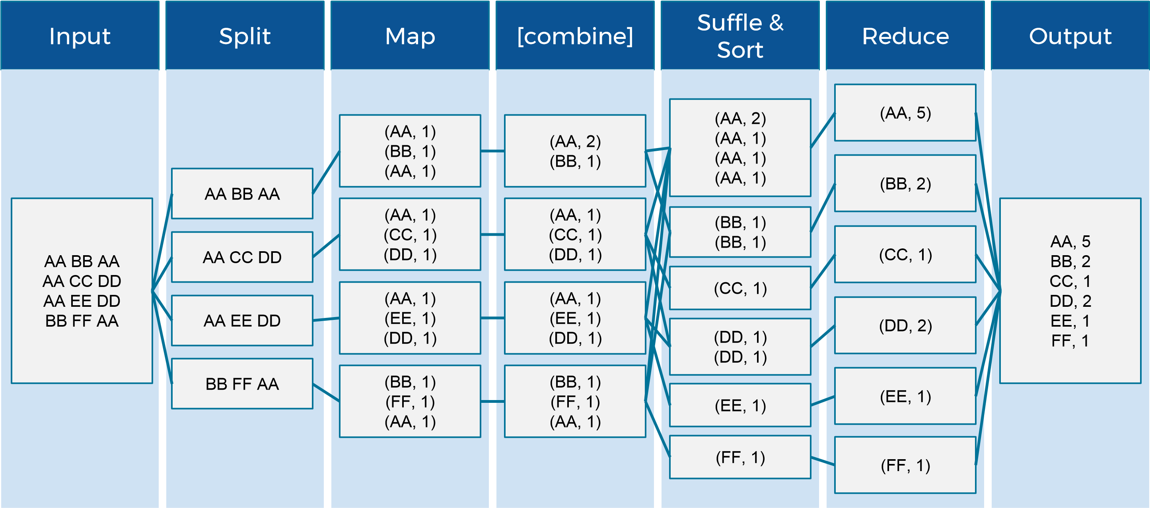
Map Reduce

Slide 28
Data Model for Common Big Data Products

Slide 29
Relational Data Model

Slide 30
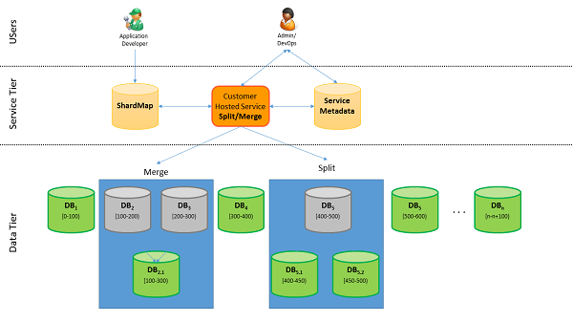
RDBMS Sharding

Slide 31
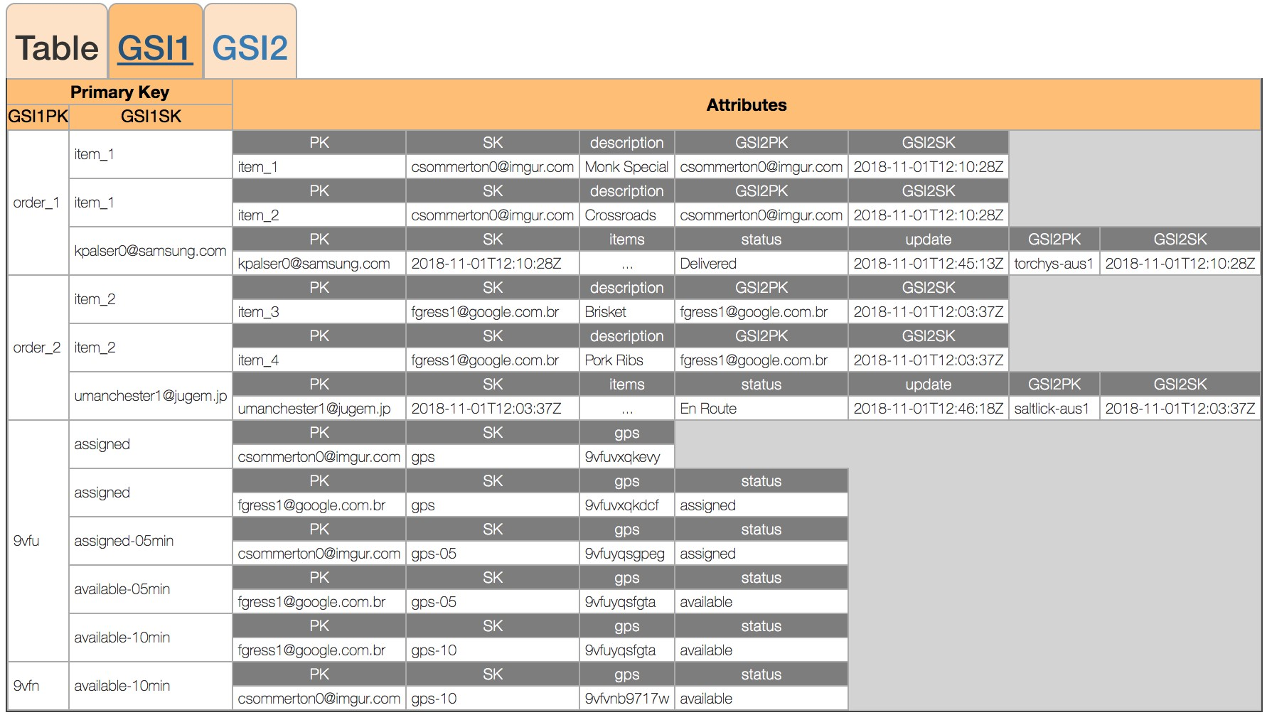
No SQL Data Model

Slide 32
Key Ideas between RDB and Non-SQL
 | Relation Database | Cloud
Data Integrity | Enforced, such as foreign key reference, no empty, unique, value range | Normally not enforced
Data Normalization | Follow 1st , 2nd , 3rd NF, sometime BNF | Denormalized, data duplicated and keep local
Transactional | Strong consistency | CAP, tunable consistency or eventually consistency
Recovery | Auto backup, transactional log, restart for recovery. | Fall back to replicas

Slide 33
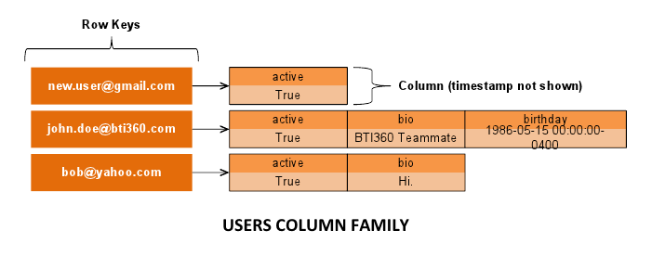
Cassandra / Dynamo Data model (hierarchical views)

Slide 34
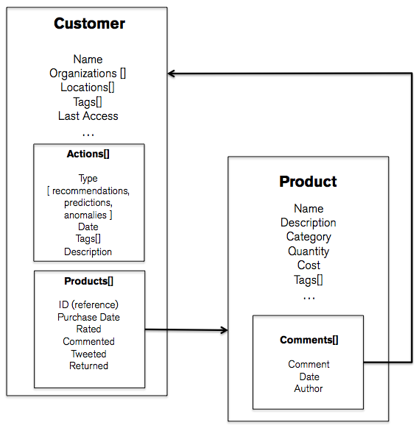
Mango DB Schema

Slide 35
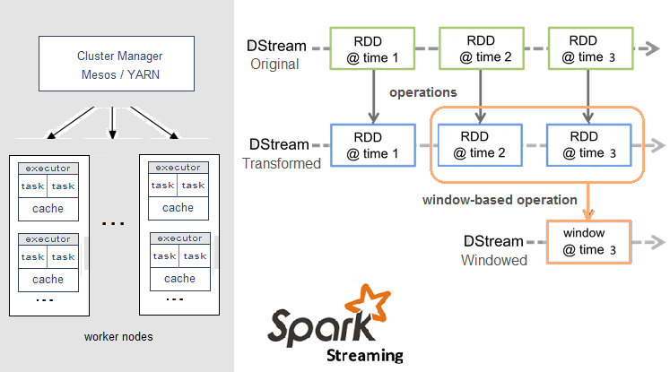
Spark
RDD = Resilient Distributed Datasets

Slide 36
Redis Data Structure (in memory cache)
Strings
Binary-safe strings is most commonly used data structure to store simple key-value data.
Sets
Collection of unique, unsorted string elements.
Lists
Collection of string elements sorted in insertion order (linked lists).
Sorted sets
Similar to set with every element associated to floating number value, called SCORE. Supports range queries.
Hashes
Which are maps composed of fields associated with values. Both the field and value are strings.
HyperLogLogs
Probabilistic data structure used in order to count unique things.

Slide 37

Kafka Streaming
Producer
Producer
Producers
Kafka
Broker
Broker
Broker
Broker
Cluster
Zookeeper
Consumers
Offsets
Consumer
Consumer

Slide 38
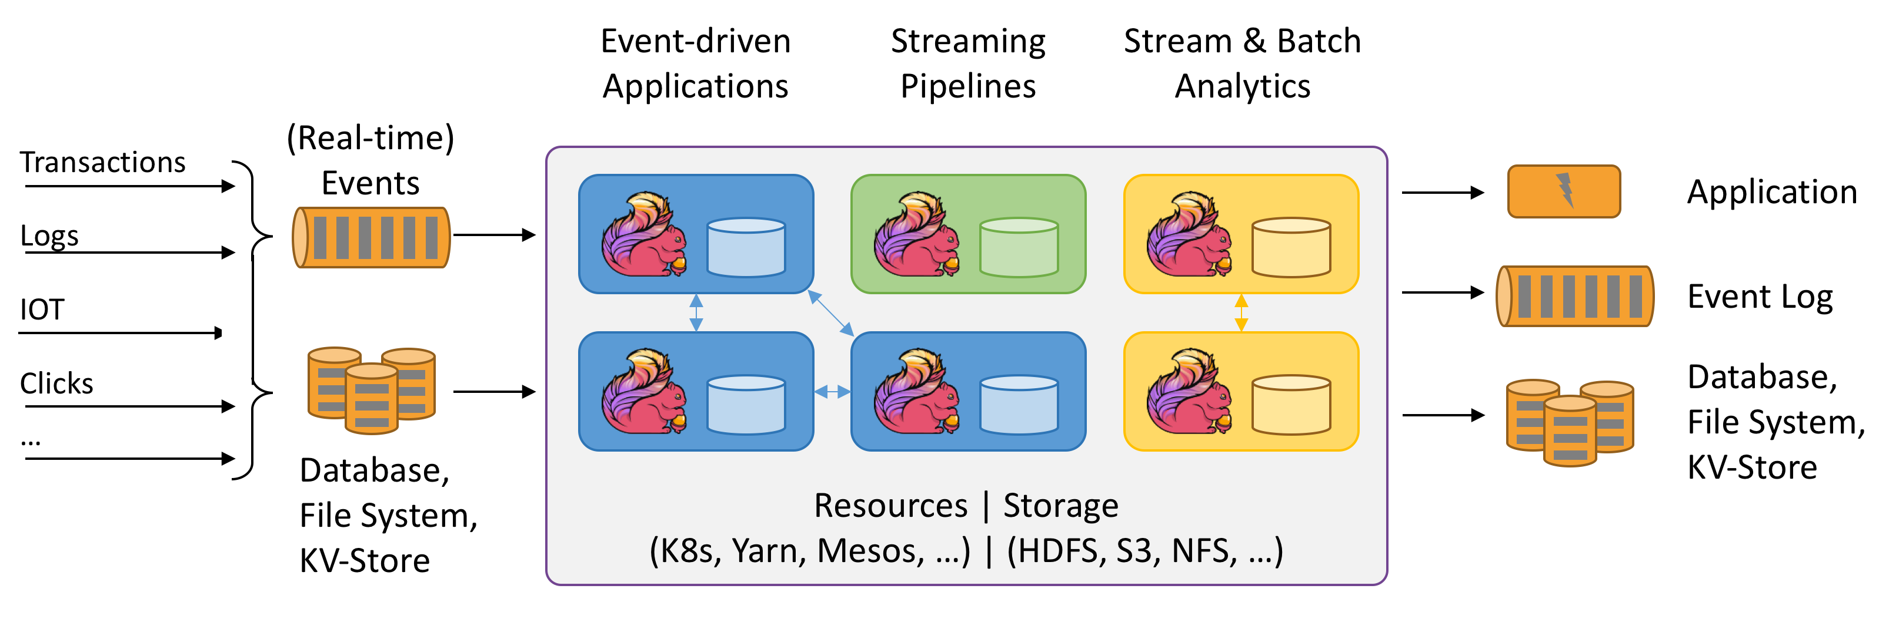
Flink Streaming

Slide 39
Storage and Retrieval

Slide 40
Data Storage Common Sense
Sequential Write (Append) is much faster than random write.
Index will help read performance, but hurt write performance.
A bulk read (with data clustered together) is much faster than random I/O.
Join is evil forecloud architecture because you need to transfer data across the network.

Slide 41
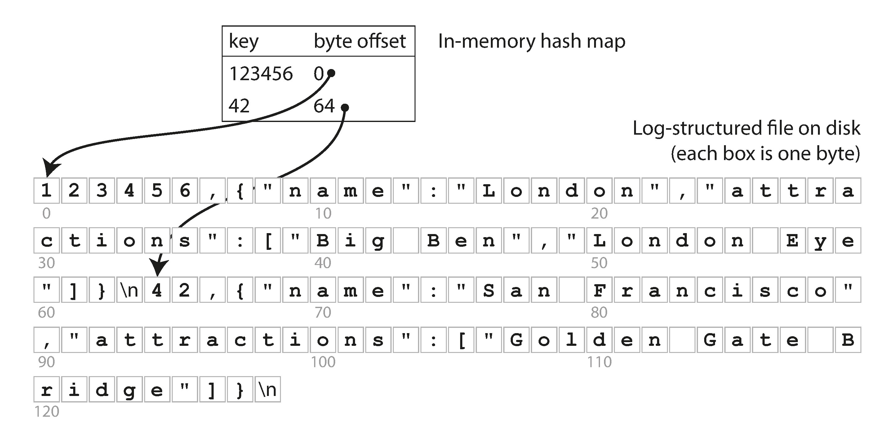
Hash Indexes

Slide 42
Compact Update Logs
Instead of modifying a record, write a new one.
Instead of deleting a record, establish a tombstone
Merge the latest version of the record to a new page and delete old pages.
The hash map are in memory, but when crash can be restored from active segment files on disk.
Checksum to avoid partially written records.
Concurrency model may be required.

Slide 43
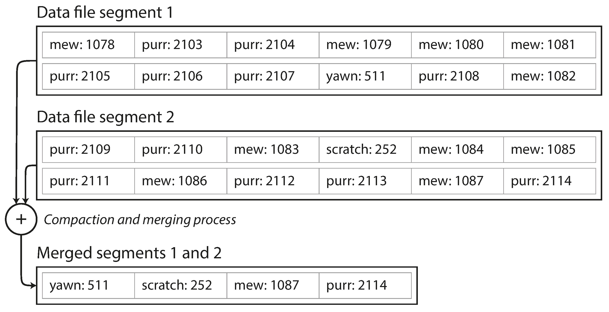
Compact and Merge

Slide 44
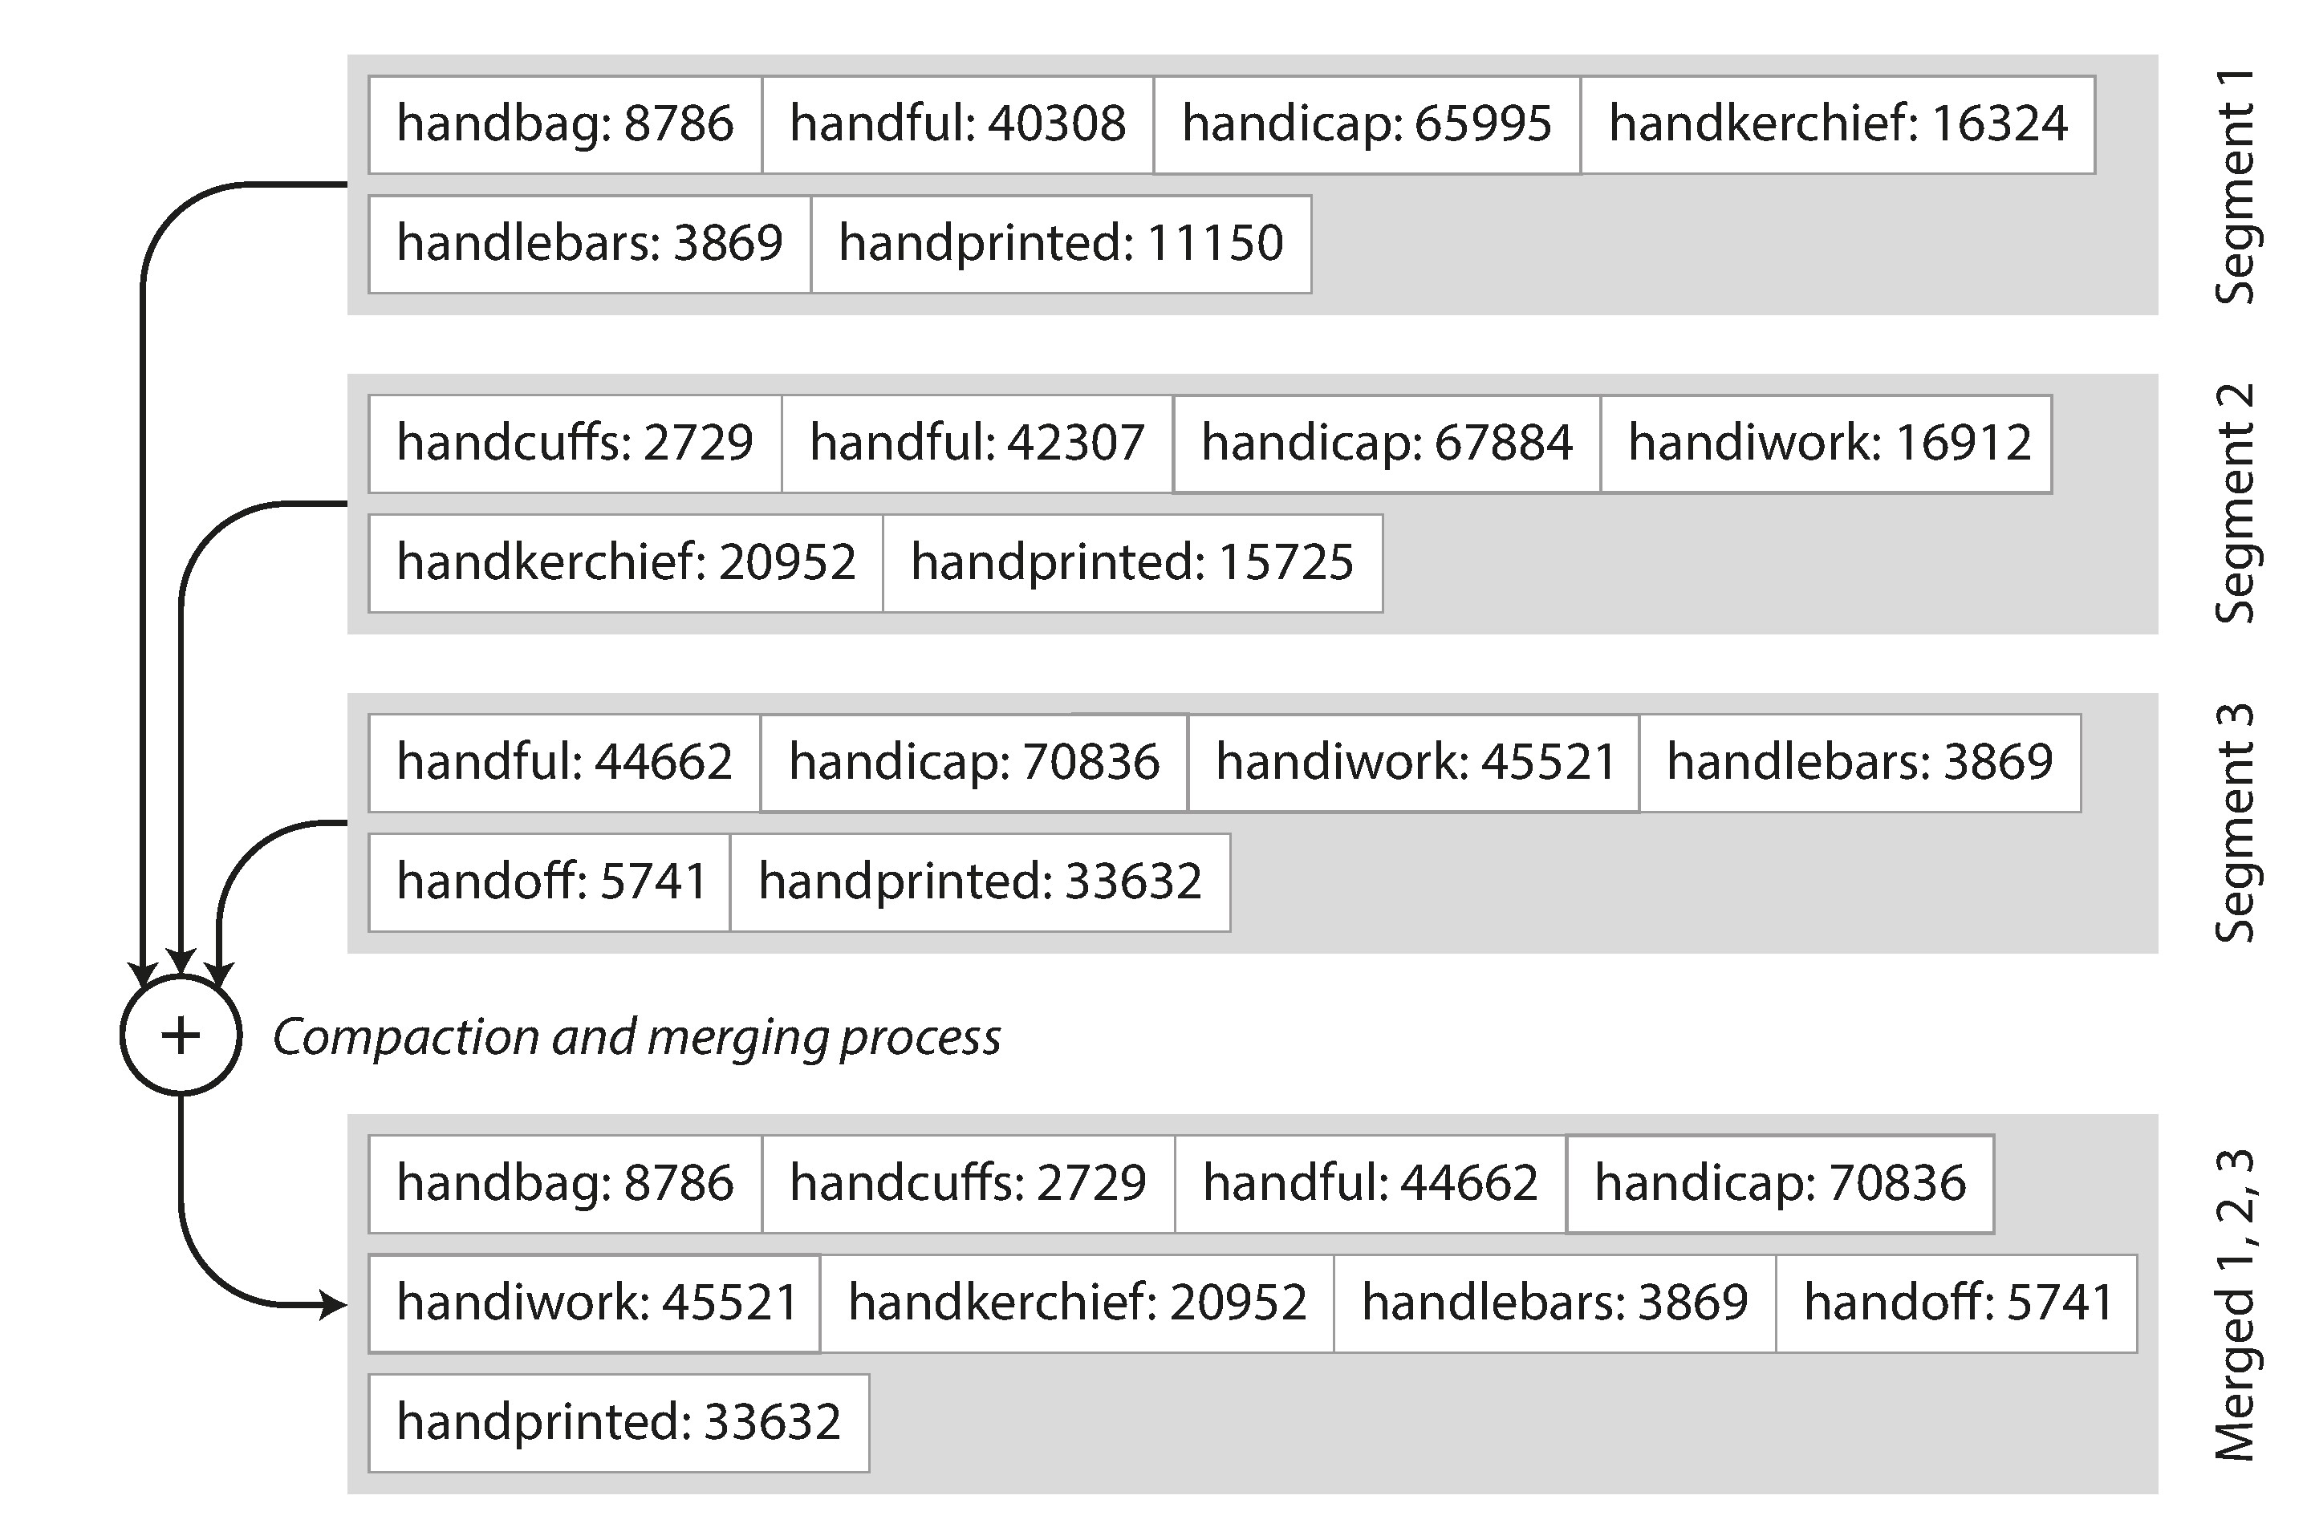
Sorted String Tables(SSTables)

Slide 45
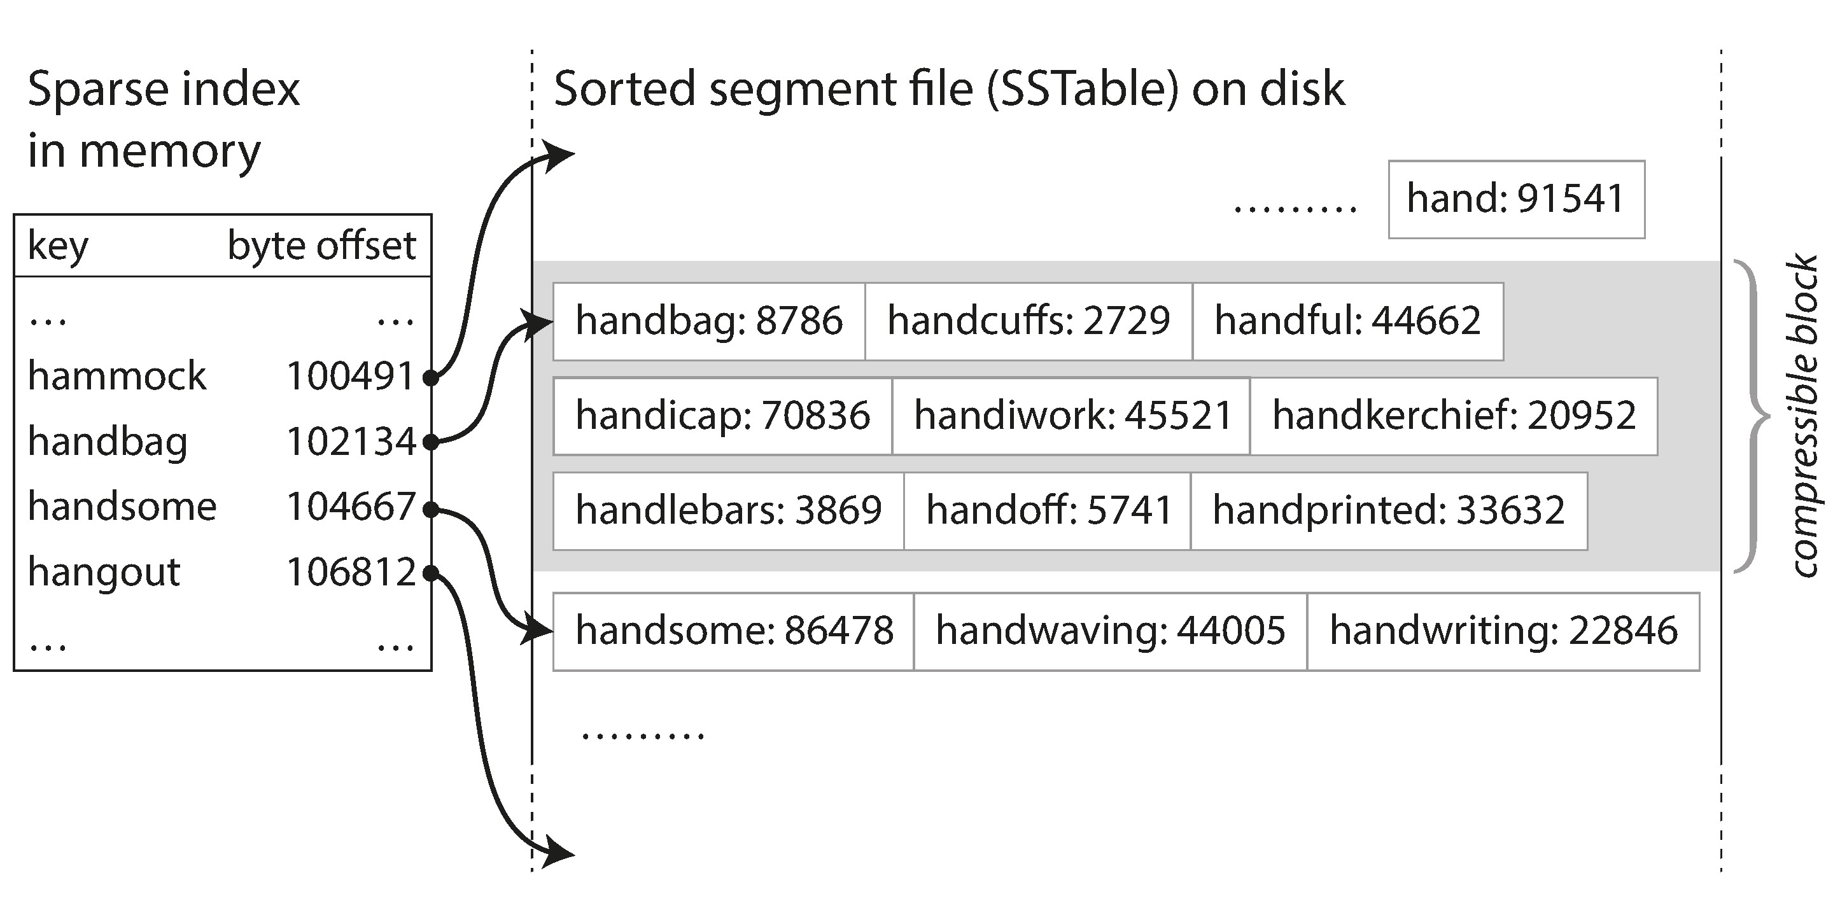
SSTables makes search faster
* The SS table is stored as a B-Trees in memory

Slide 46
LSM Tree
Writes go to a set of smaller index files.
Each index file is sorted and then immutable.
Read inspect all files
Periodically files are merged together to keep number of files down

Slide 47
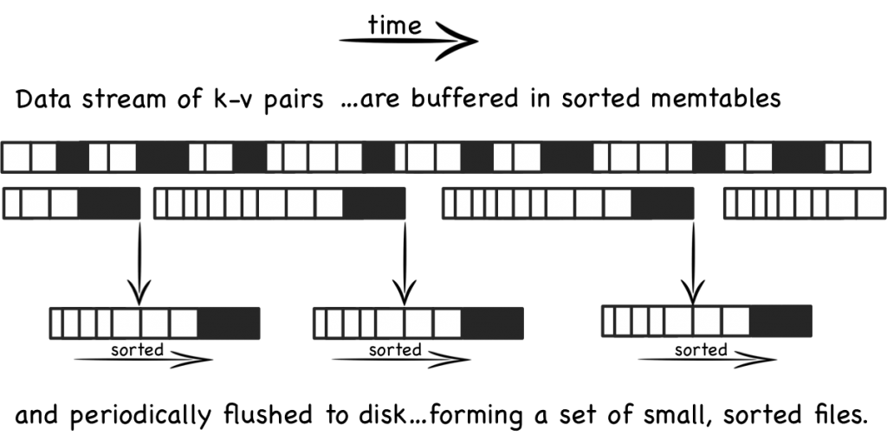
Log structured Merge Trees

Slide 48
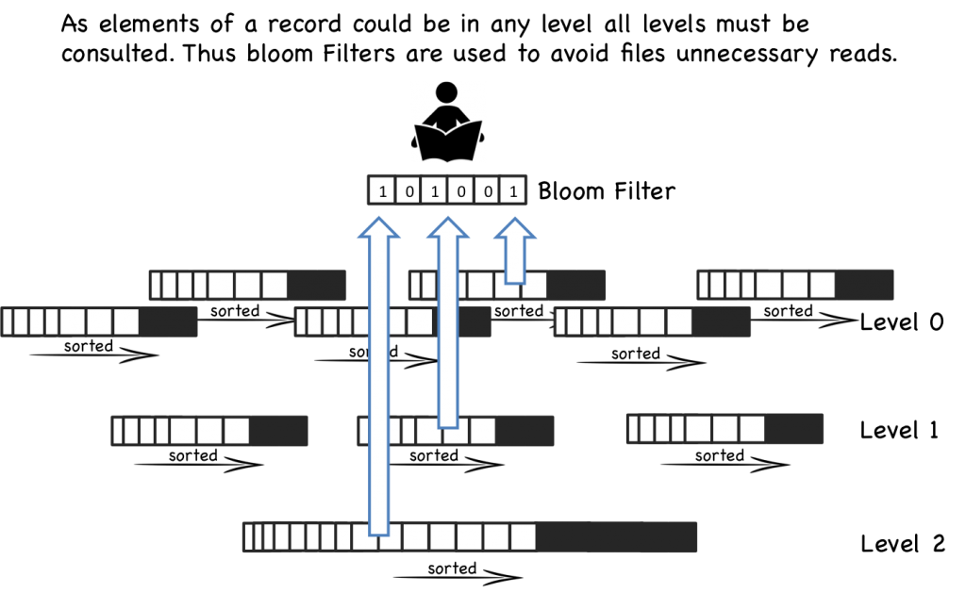
Data can be at any level of LSM tree

Slide 49
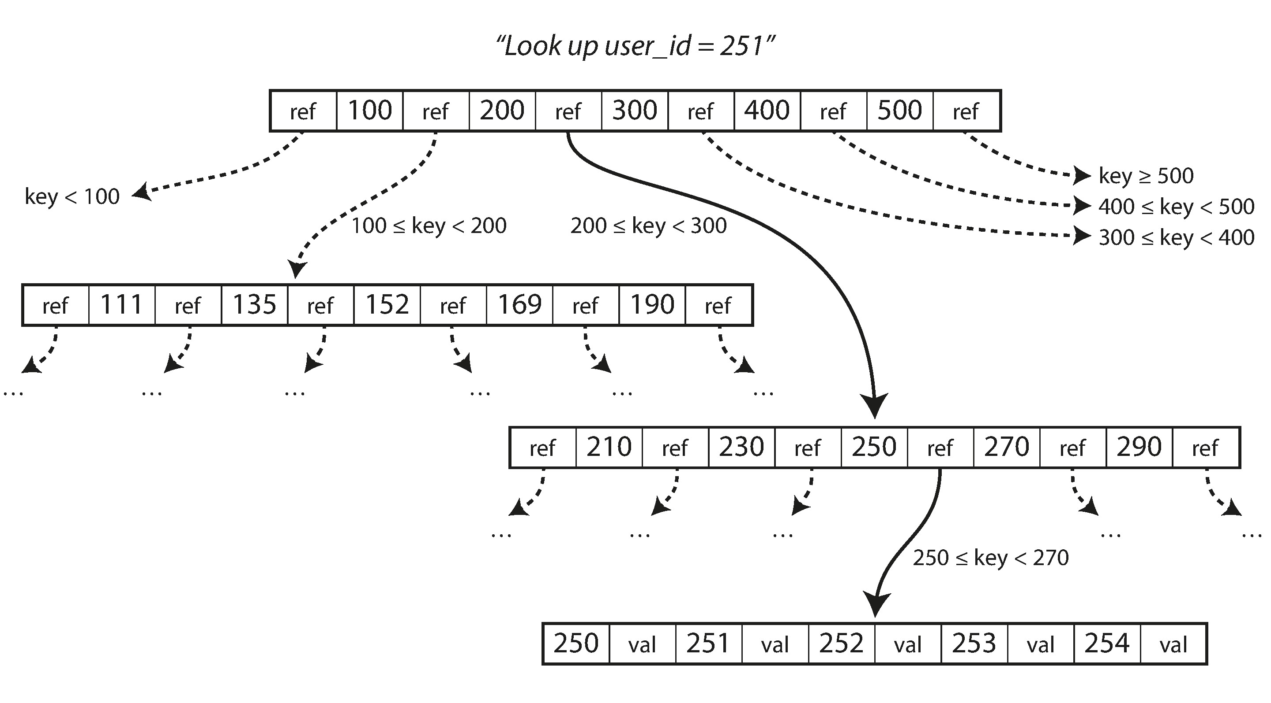
B-Trees

Slide 50
B-Trees Key Characters
The basic underlying write operation of a B-tree is to overwrite a page on disk with new data. It is assumed that the overwrite does not change the location of the page.
B-Tree needs write ahead log (WAL) to be resilient to crash, or it can use copy-on-write when page is modified.
We can save space in pages by not storing the entire key, but abbreviating it.
Use clustered index as much as possible.
Additional pointers have been added to the tree. For example, each leaf page may have references to its sibling pages to the left and right, which allows scanning keys in order without jumping back to parent pages.
B-tree variants such as fractal trees, borrow some log-structured ideas to reduce disk seeks (and they have nothing to do with fractals).

Slide 51
Compare LSM-Tree and B-Tree
LSM Tree
B Tree
Less Write needed
Sequential Write, high throughput
Not page oriented
Compress better, smaller disk files, no fragmentation
Compaction process impact read performance.
Multiple instance of key, not good for transaction isolation
More writes needed (whole page)
Random writes, low throughput
Page oriented
Leave some disk space unused in a page.
Direct read.
Single instance of key, good for transaction isolation.

Slide 52
R-Tree
Proposed by Antonin Guttman in 1984, used for spatial access methods
Idea is to group nearby objects and represent them with minimum bounding rectangle.
R-Tree is a balanced search tree with pages can contain a maximum number of entries, for best performance filling rate is 30% to 40%.
R-tree do not guarantee good worst-case performance, but in real world, doing well.
For more details: https://en.wikipedia.org/wiki/R-tree

Slide 53
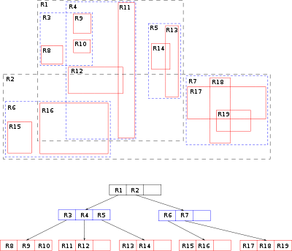
R-Tree Example

Slide 54
Comparison between OLTP and OLAP
Property | Transaction processing systems (OLTP) | Analytic systems (OLAP)
Main read pattern | Small number of records per query, fetched by key | Aggregate over large number of records
Main write pattern | Random-access, low-latency writes from user input | Bulk import (ETL) or event stream
Primarily used by | End user/customer, via web application | Internal analyst, for decision support
What data represents | Latest state of data (current point in time) | History of events that happened over time
Dataset size | Gigabytes to terabytes | Terabytes to petabytes

Slide 55
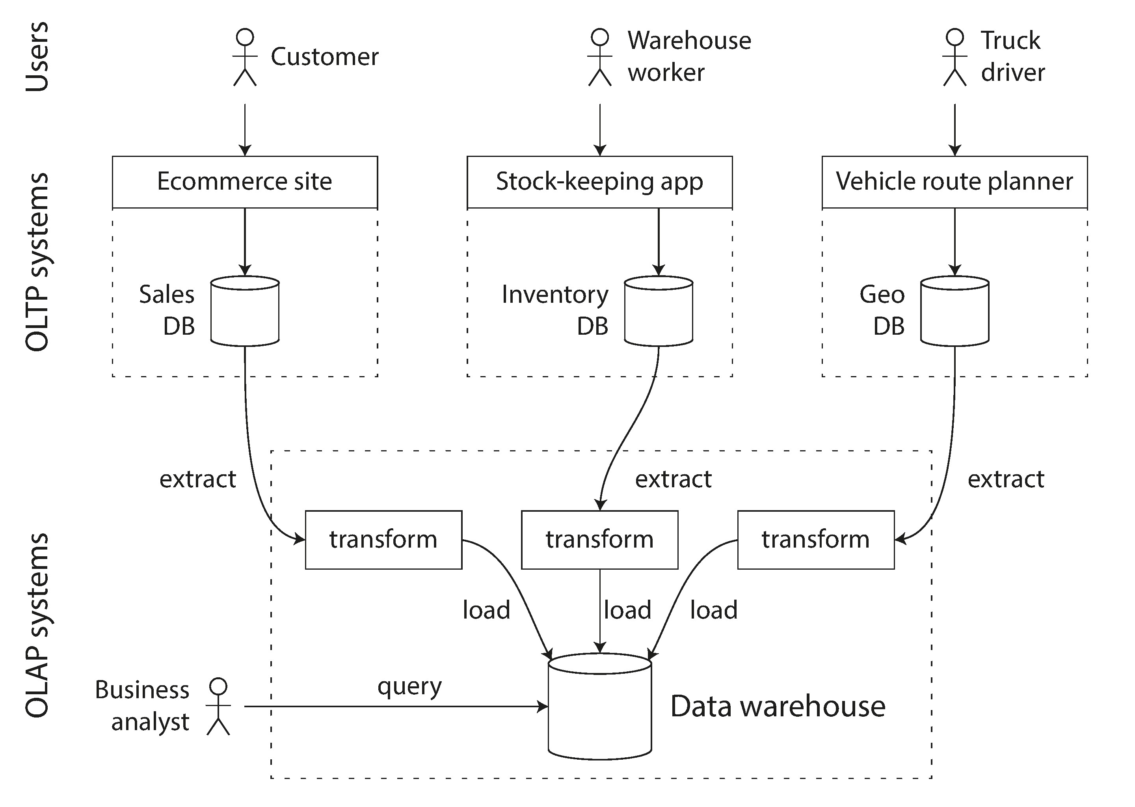
Data ETL

Slide 56
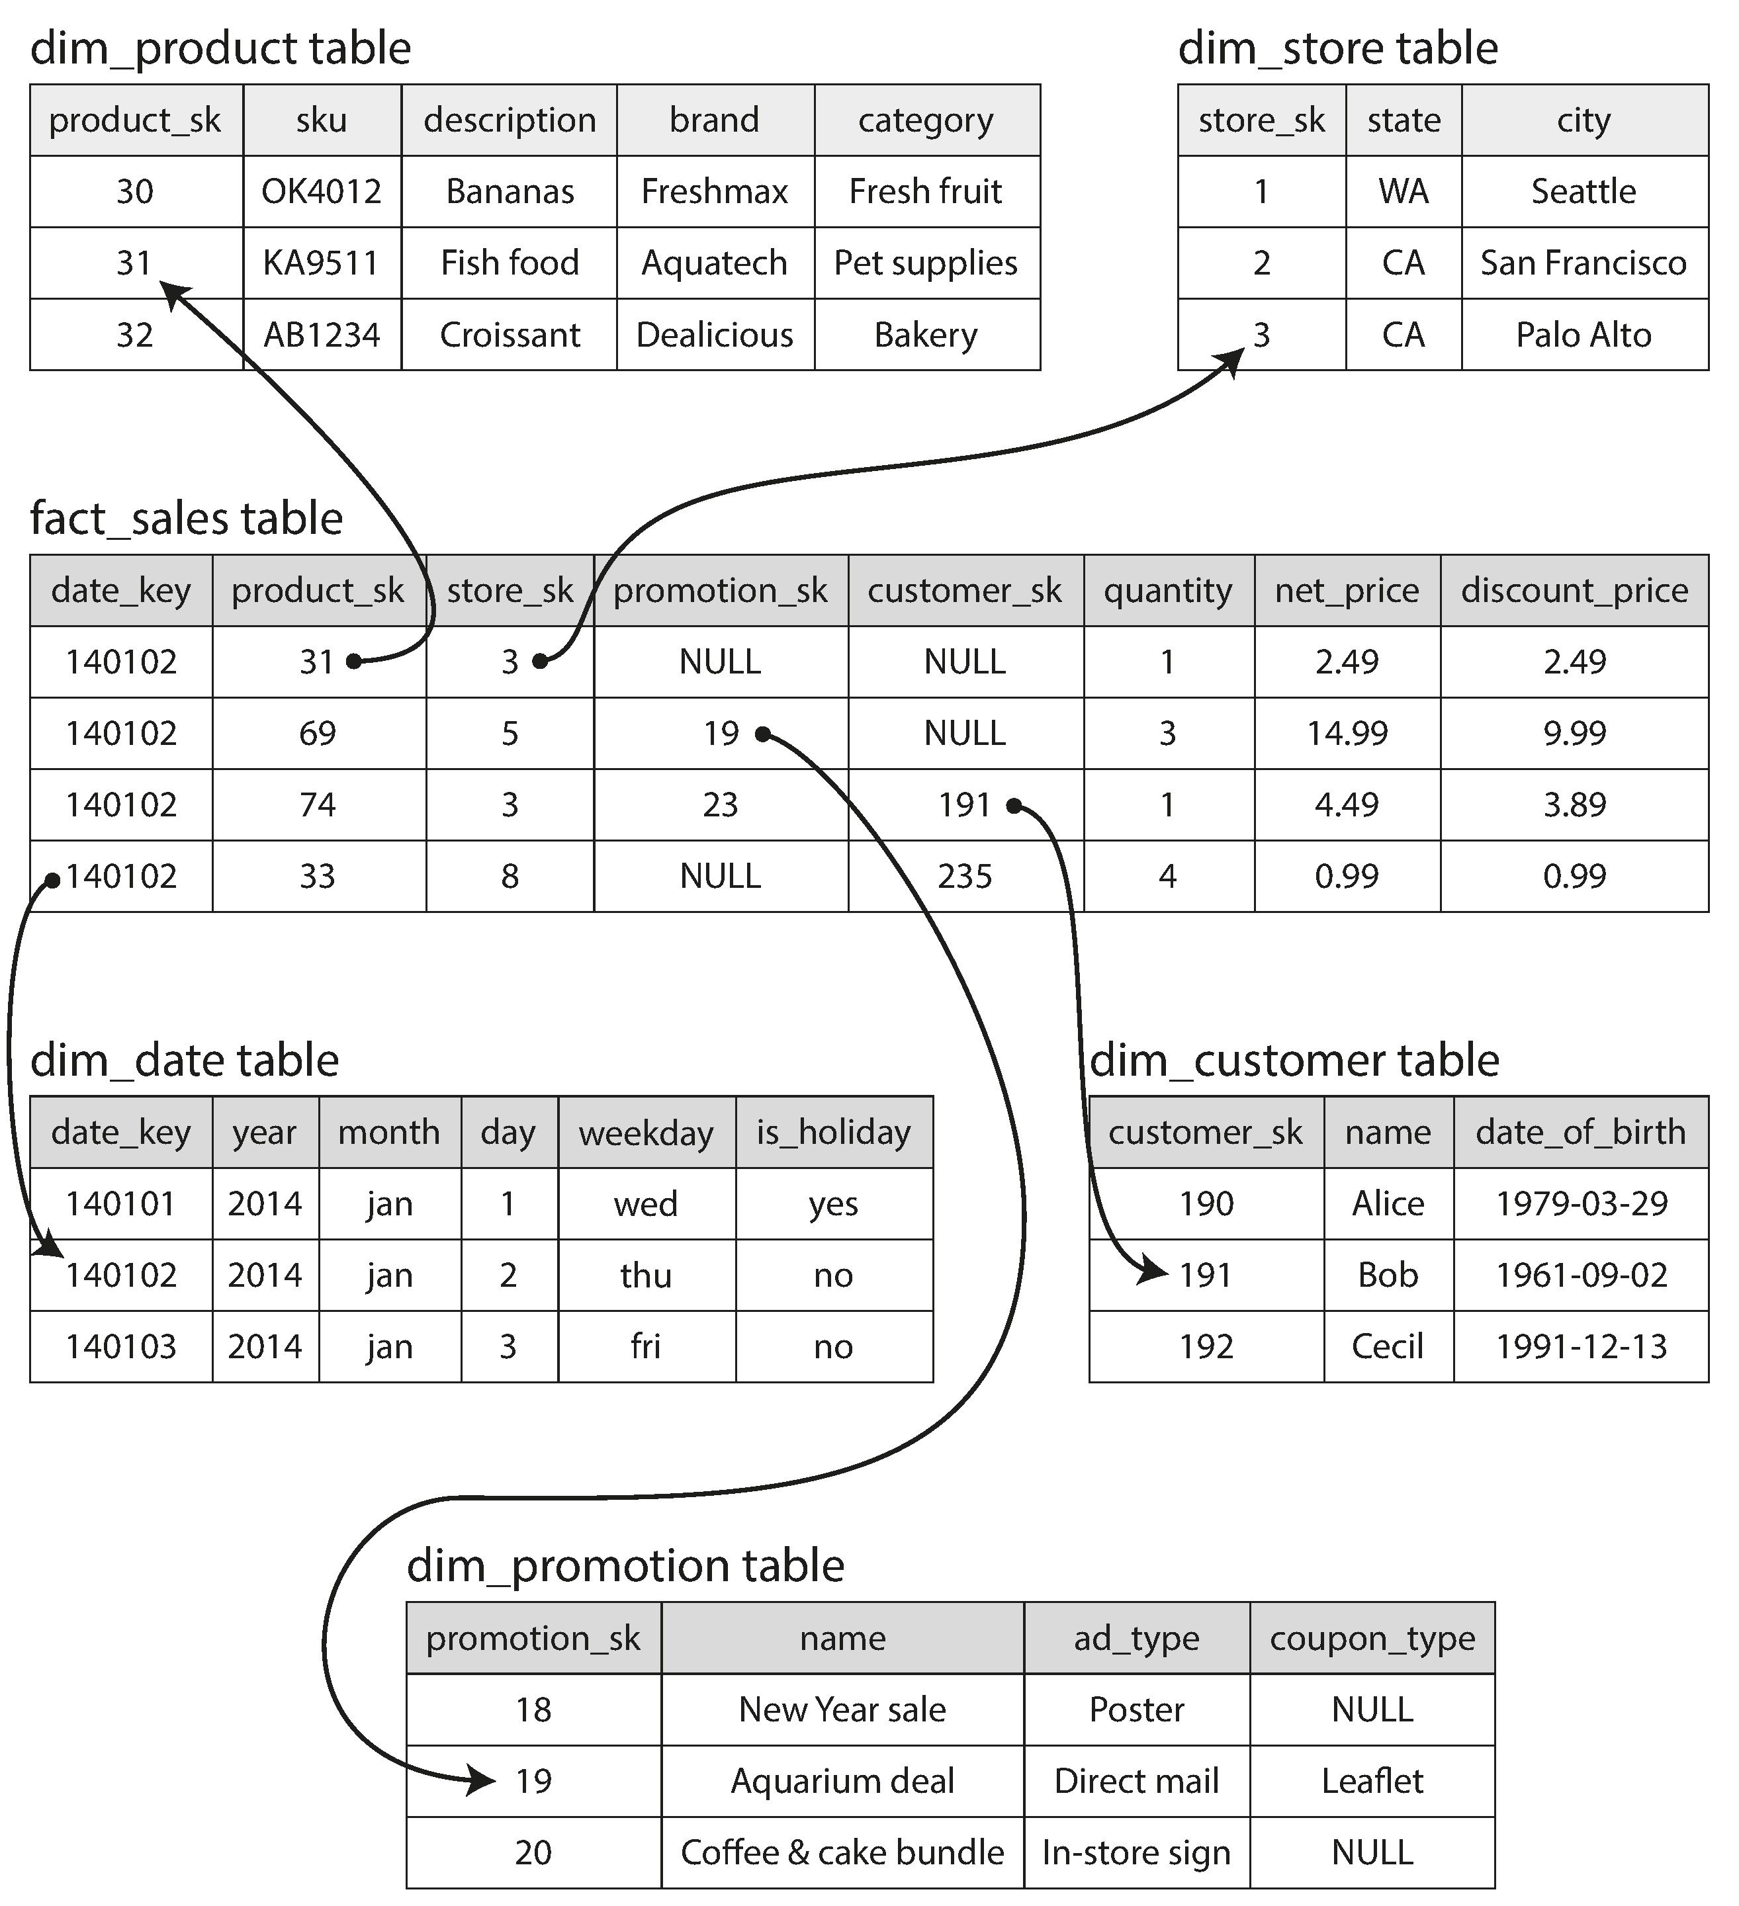
Star Schema for Analytics

Slide 57
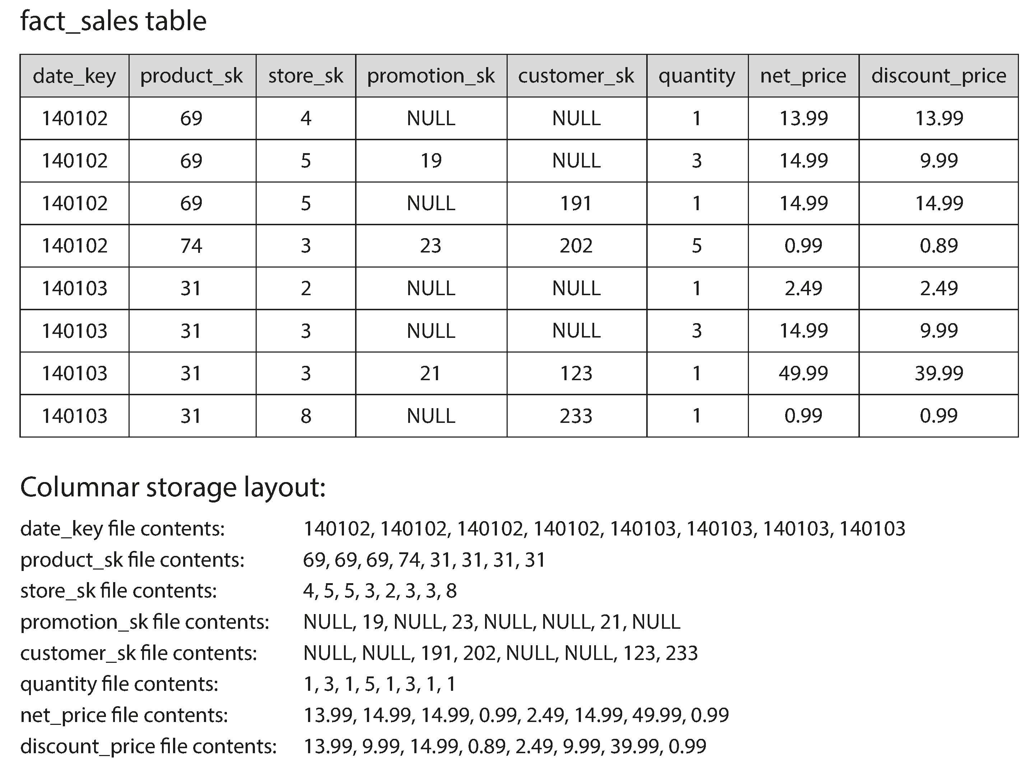
Column Store
* In every analytics query we only select very few columns

Slide 58
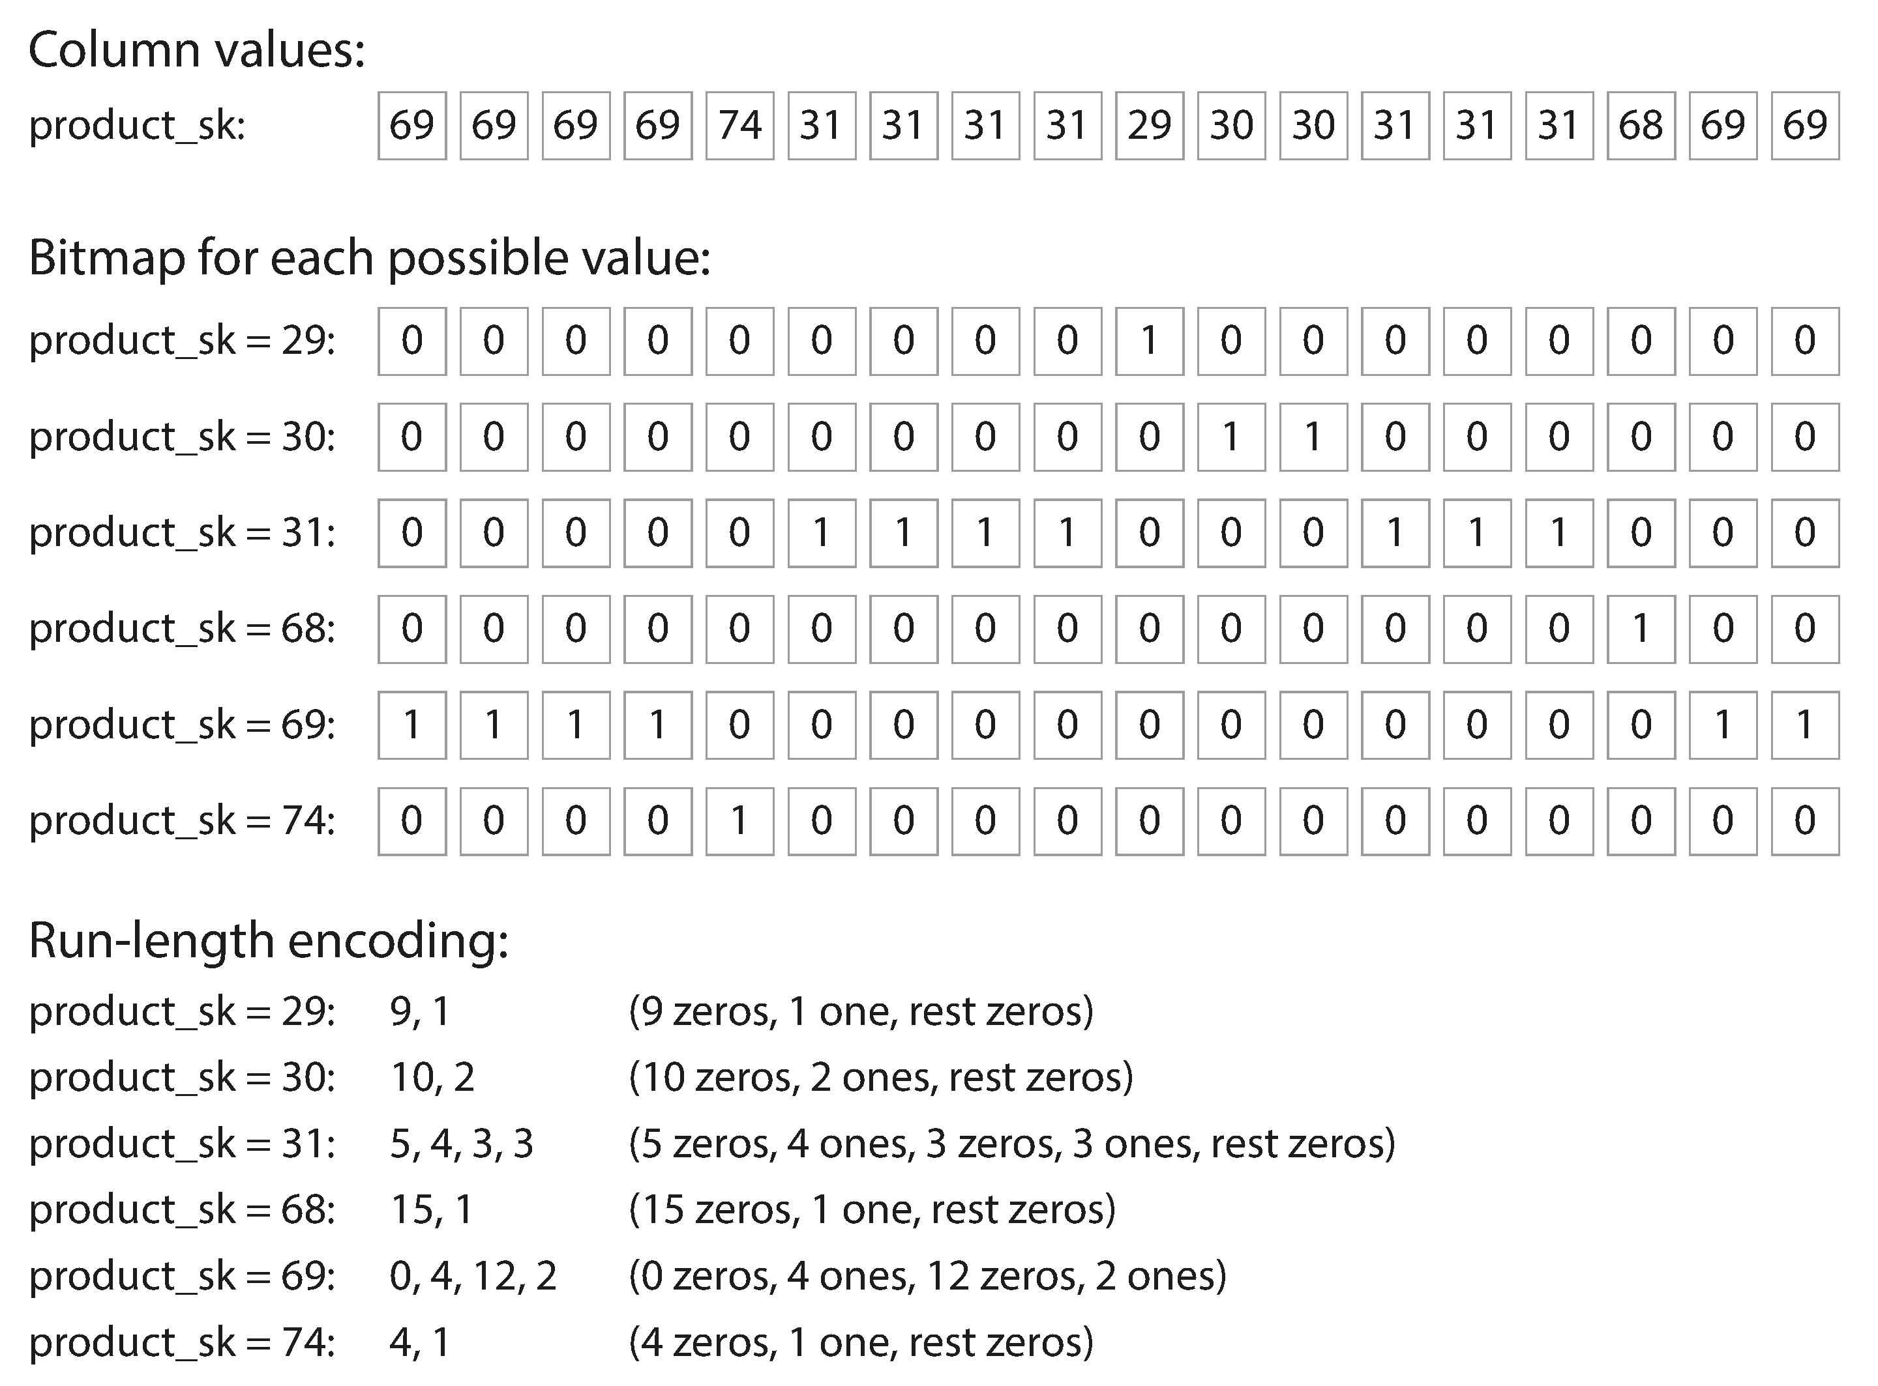
Column Store Compression
Column store table is bad for update, so normally immutable.

Slide 59
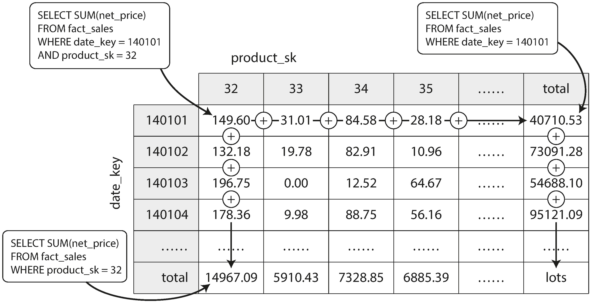
Data Cube in Data Warehouse

Slide 60
Encoding

Slide 61
Encoding
Backward compatibility
Newer code can read data written by older code
Forward compatibility
Older code can read data written by newer code.
Text format
JSON, XML and CSV
Language-Specific Formats, normally a bad idea.
java.io.serializable
Binary format
Protocol Buffers, Thrift and Avro

Slide 62
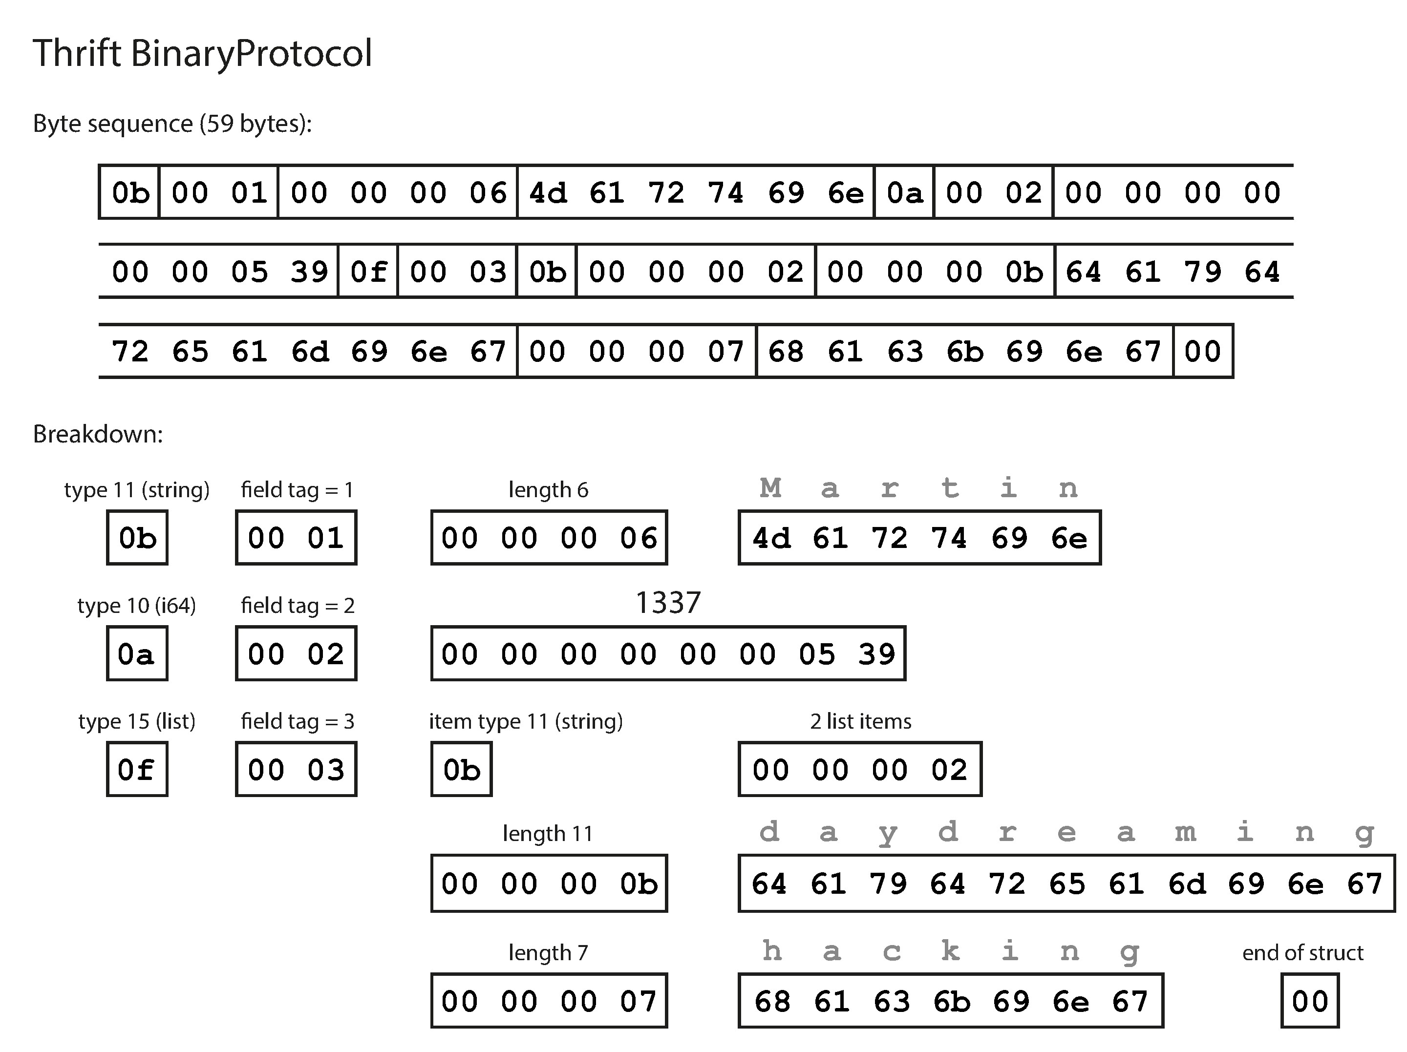
Thrift Binary Protocol

Slide 63
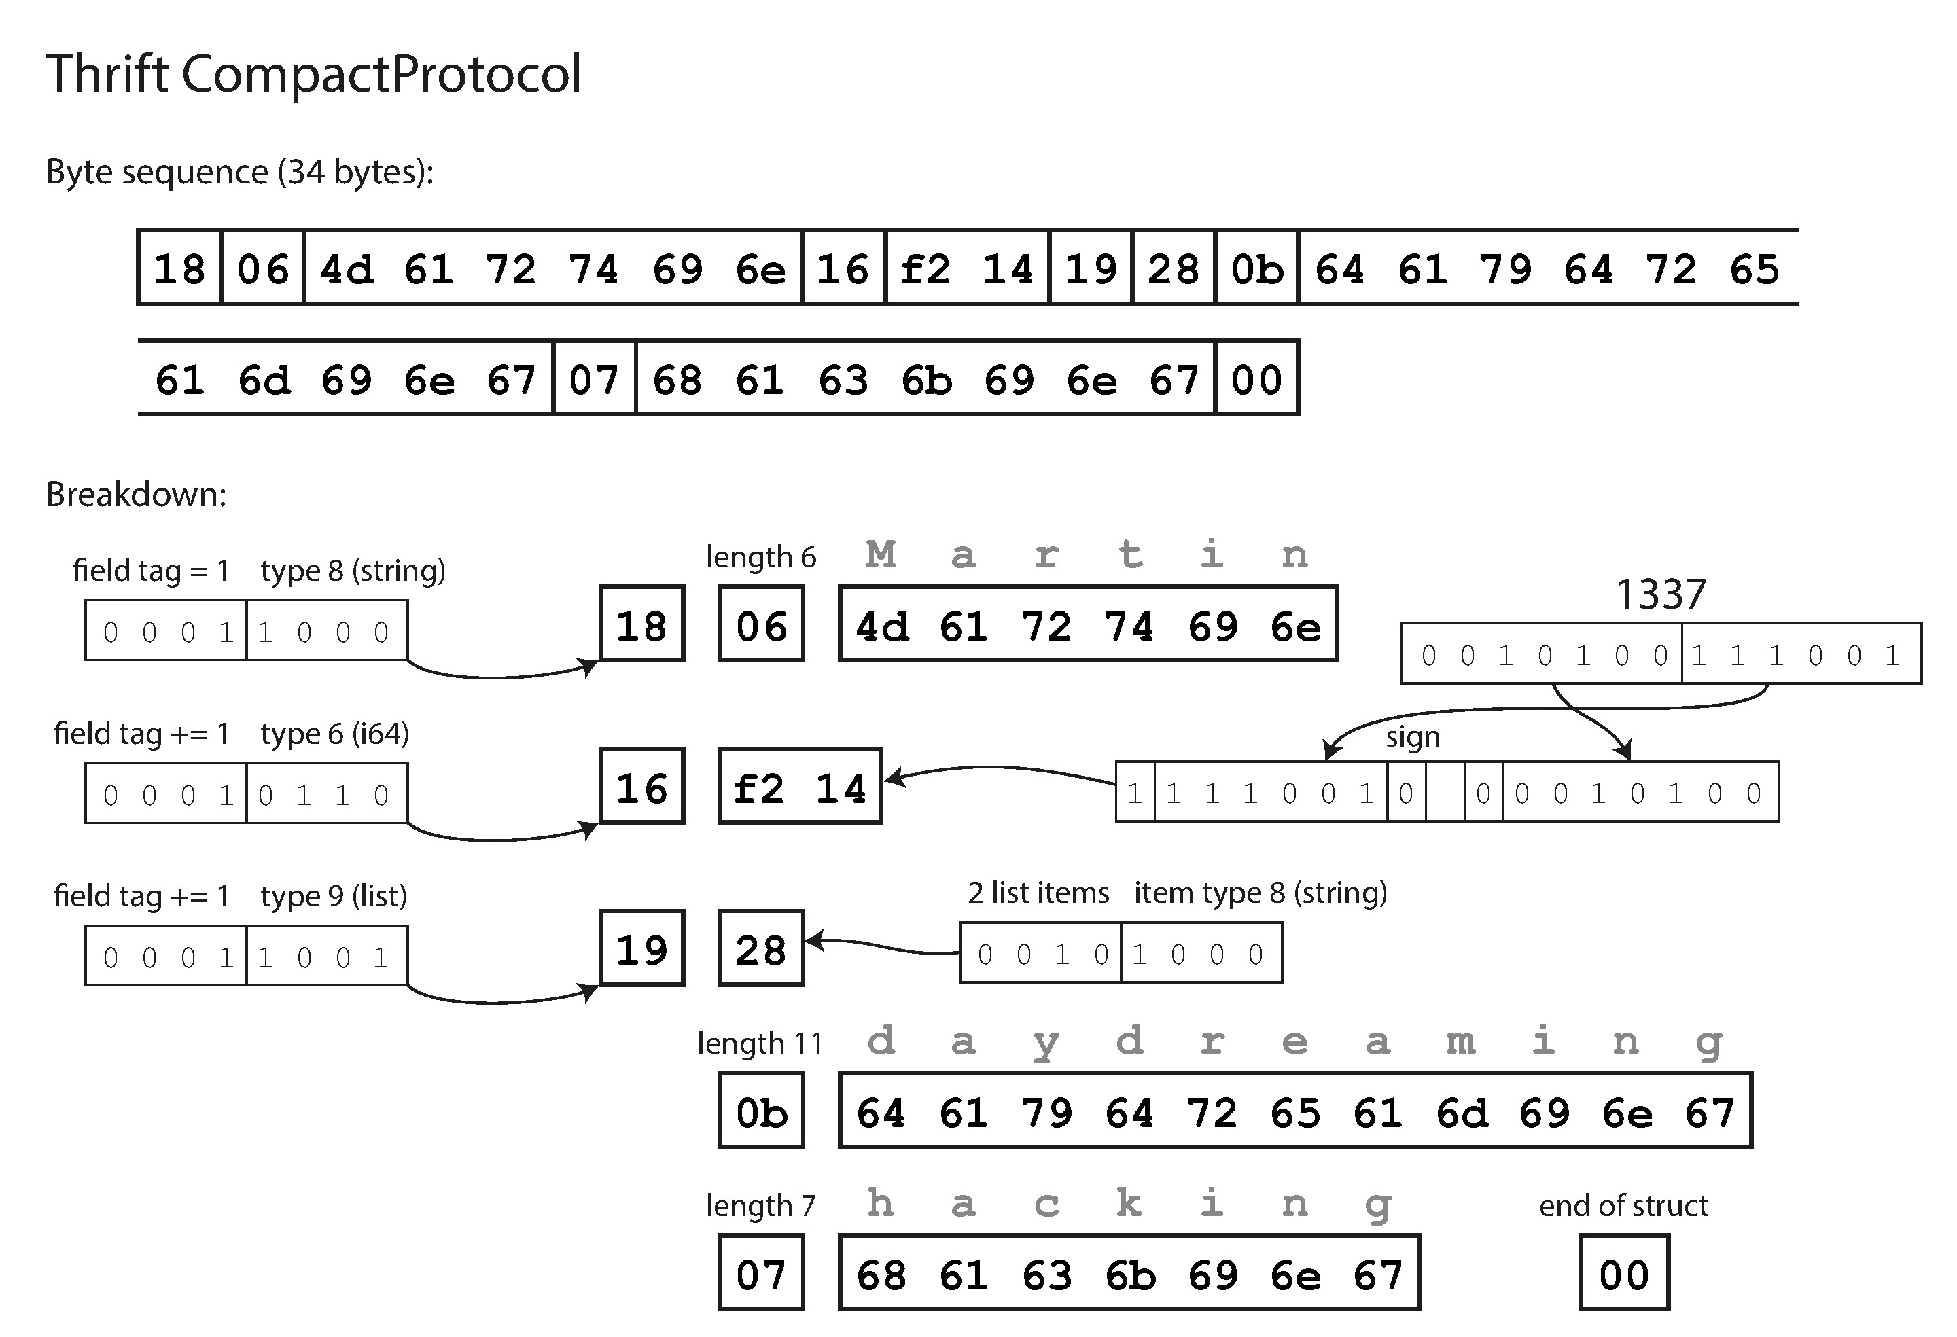
Thrift Compact Protocol

Slide 64
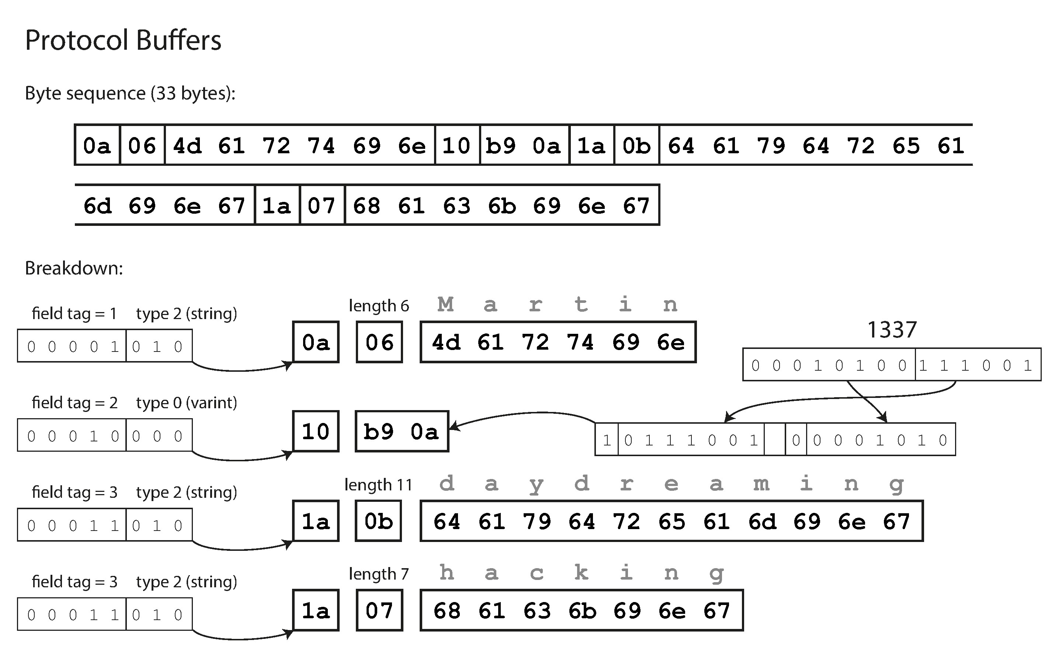
Protocol Buffer

Slide 65
Avro Schema Definition
Starting from 2009, a sub project of Hadoop
Schema definition
Avro schemas are defined using JSON. Schemas are composed of primitive types (null, boolean, int, long, float, double, bytes, and string) and complex types (record, enum, array, map, union, and fixed).
Simple schema example:
{
"namespace": "example.avro",
"type": "record",
"name": "User",
"fields": [
{"name": "name", "type": "string"},
{"name": "favorite_number", "type": ["int", "null"]},
{"name": "favorite_color", "type": ["string", "null"]}
]
}

Slide 66
Avro Serializing and Deserializing
Serialization
import avro.schema
from avro.datafile import DataFileReader, DataFileWriter
from avro.io import DatumReader, DatumWriter
schema = avro.schema.parse(open("user.avsc").read()) # need to know the schema to write
writer = DataFileWriter(open("users.avro", "w"), DatumWriter(), schema)
writer.append({"name": "Alyssa", "favorite_number": 256})
writer.append({"name": "Ben", "favorite_number": 7, "favorite_color": "red"})
writer.close()
Deserialization
reader = DataFileReader(open("users.avro", "r"), DatumReader()) # no need to know the schema to read
for user in reader:
print user
reader.close()
Output
{u'favorite_color': None, u'favorite_number': 256, u'name': u'Alyssa'}
{u'favorite_color': u'red', u'favorite_number': 7, u'name': u'Ben'}

Slide 67
Avro Data Format
$ od -c users.avro
0000000 O b j 001 004 026 a v r o . s c h e m
0000020 a 272 003 { " t y p e " : " r e c
0000040 o r d " , " n a m e s p a c e
0000060 " : " e x a m p l e . a v r o
0000100 " , " n a m e " : " U s e r
0000120 " , " f i e l d s " : [ { "
0000140 t y p e " : " s t r i n g " ,
0000160 " n a m e " : " n a m e " }
0000200 , { " t y p e " : [ " i n t
0000220 " , " n u l l " ] , " n a m
0000240 e " : " f a v o r i t e _ n u
0000260 m b e r " } , { " t y p e " :
0000300 [ " s t r i n g " , " n u l
0000320 l " ] , " n a m e " : " f a
0000340 v o r i t e _ c o l o r " } ] }
0000360 024 a v r o . c o d e c \b n u l l
0000400 \0 211 266 / 030 334 ˪ ** P 314 341 267 234 310 5 213
0000420 6 004 , \f A l y s s a \0 200 004 002 006 B
0000440 e n \0 016 \0 006 r e d 211 266 / 030 334 ˪ **
0000460 P 314 341 267 234 310 5 213 6 0000471

Slide 68
Modes of Dataflow
Via databases
Vis service calls
REST and RPC
Message-Passing Dataflow
Message broker
Distributed actor frameworks
The actor model is a programming model for concurrency in a single process. Each actor typically represents one client or entity, it may have some local state (which is not shared with any other actor), and it communicates with other actors by sending and receiving asynchronous messages. Message delivery is not guaranteed: in certain error scenarios, messages will be lost. Since each actor processes only one message at a time, it doesn’t need to worry about threads, and each actor can be scheduled independently by the framework.

Slide 69
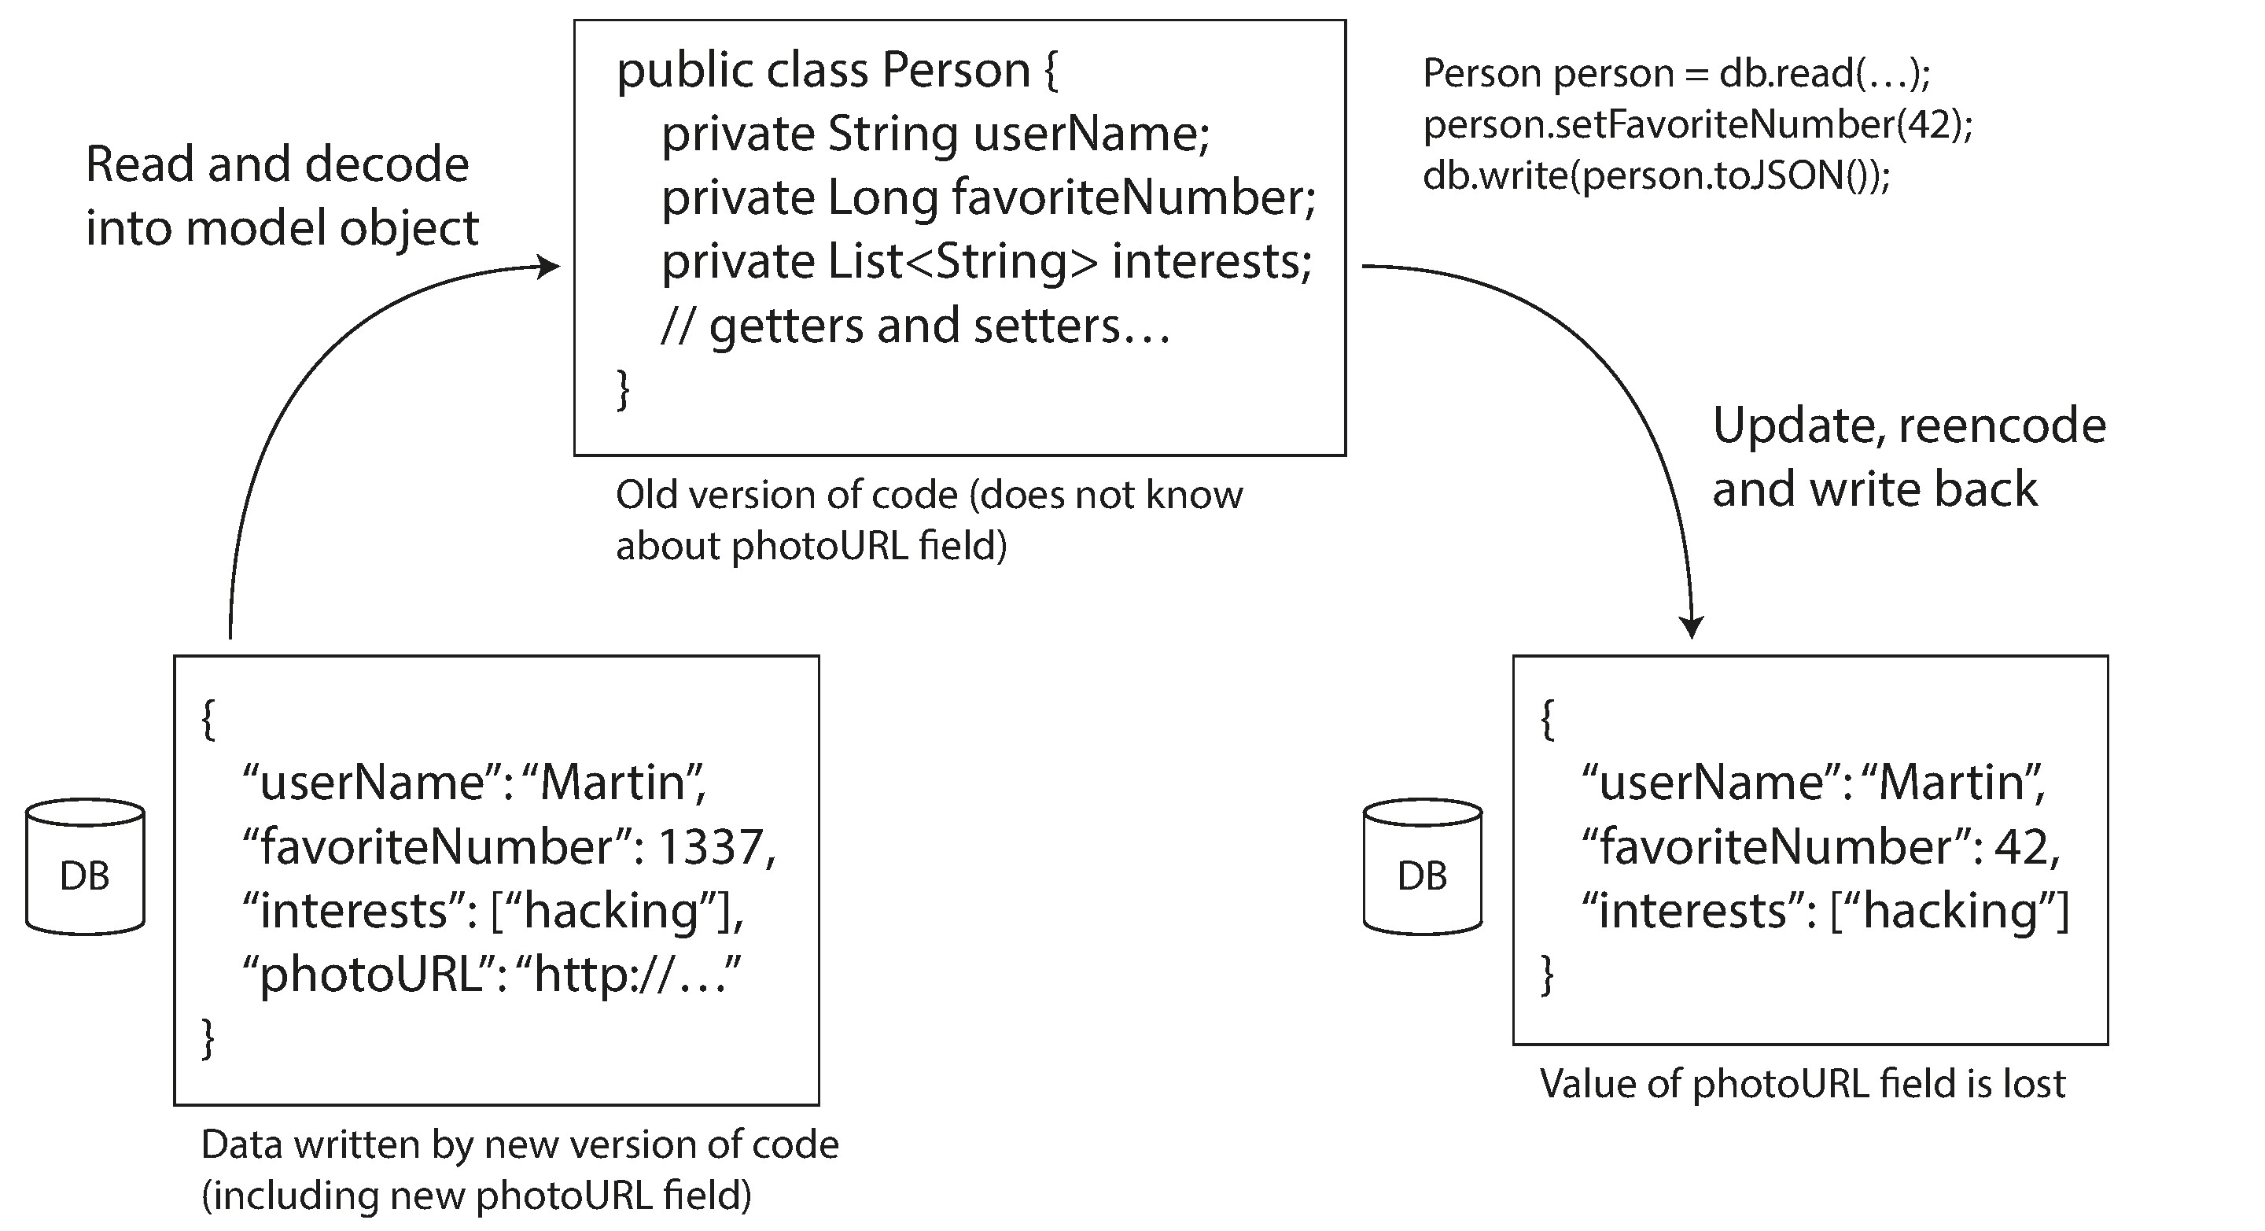
Old app update new data may cause data loss

Slide 70
Replication

Slide 71
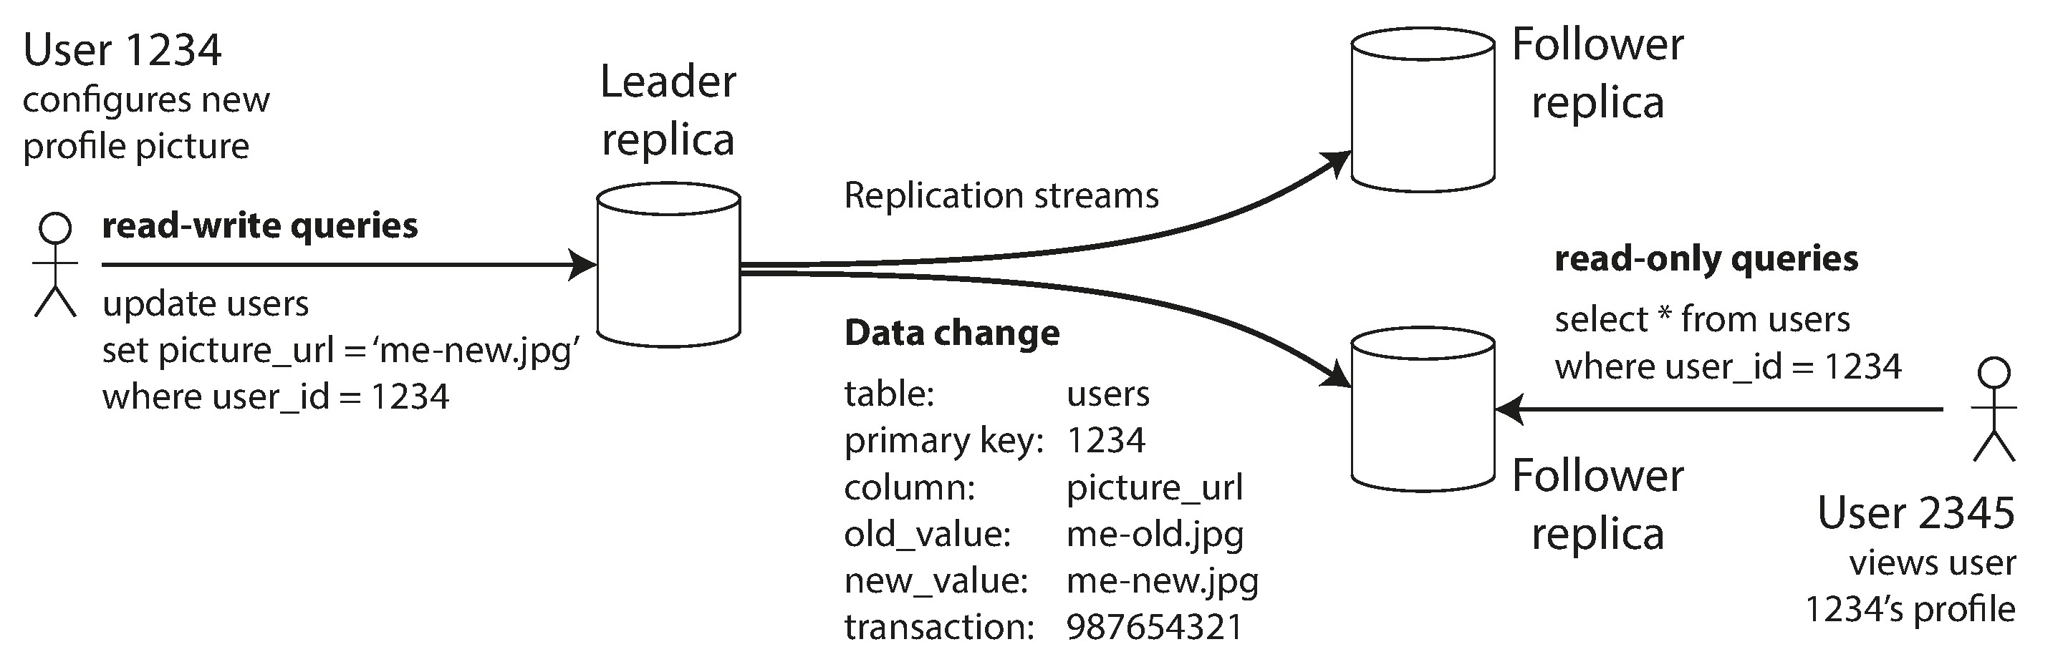
Leaders and Followers
One replica is designated the leader, which takes the writes from client, the others are followers, take the log from leader and update its local copy, i.e. applying all writes in the same order as the leader.
Either leader or followers can take the read request, but only the leader can take the writes.

Slide 72
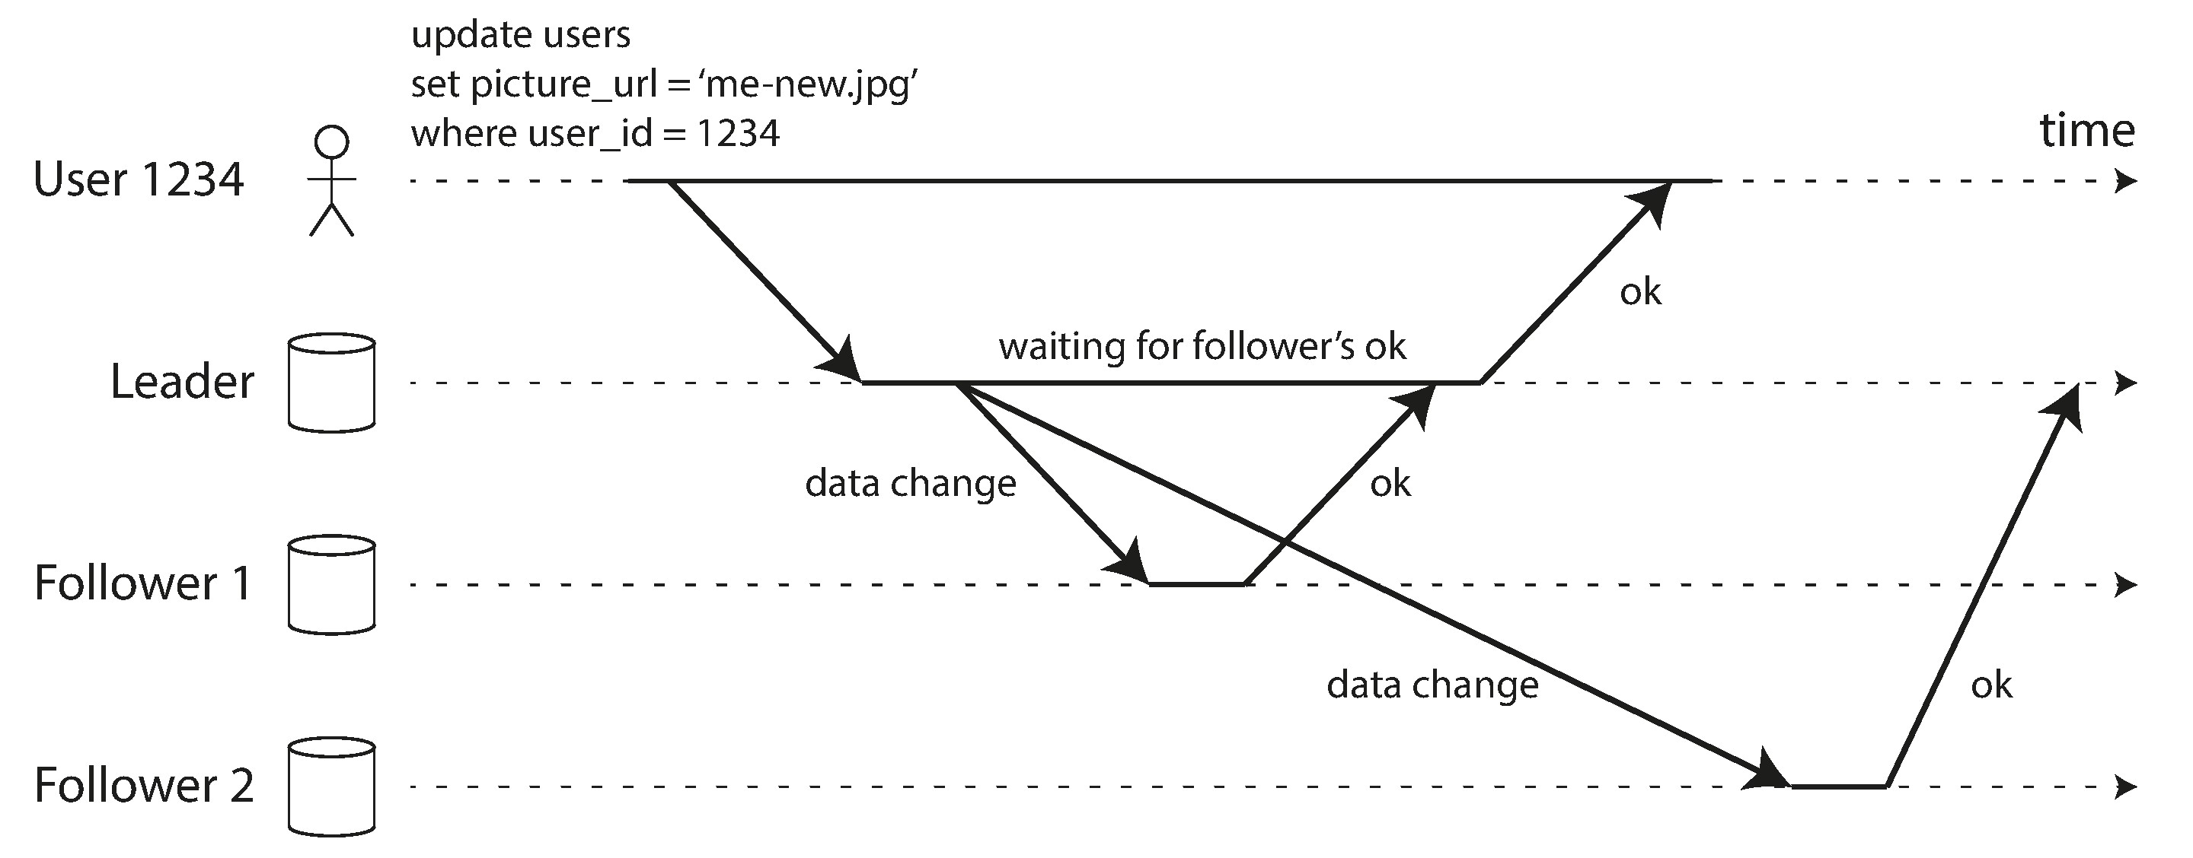
Synchronous Versus Asynchronous Replication

Slide 73
Setting Up New Followers
Take the snapshot of the leader
Copy the snapshot to the new follower node.
Catch up the changes in the log

Slide 74
Handling Node Outages
Follower failure: Catch-up recovery
Leader failure: Failover
Determine the leader failure
Choose the new leader
Reconfigure the system to use the new leader

Slide 75
Implementation of Replication Logs
Statement-based replication
Problems: nondeterministic function, for example now(), autoincrementing column, side effects function.
Write-ahead log (WAL) shipping
Physical log file replication
Logical (row-based) log replication
Decoupled with storage engine internal
Physical page replication

Slide 76
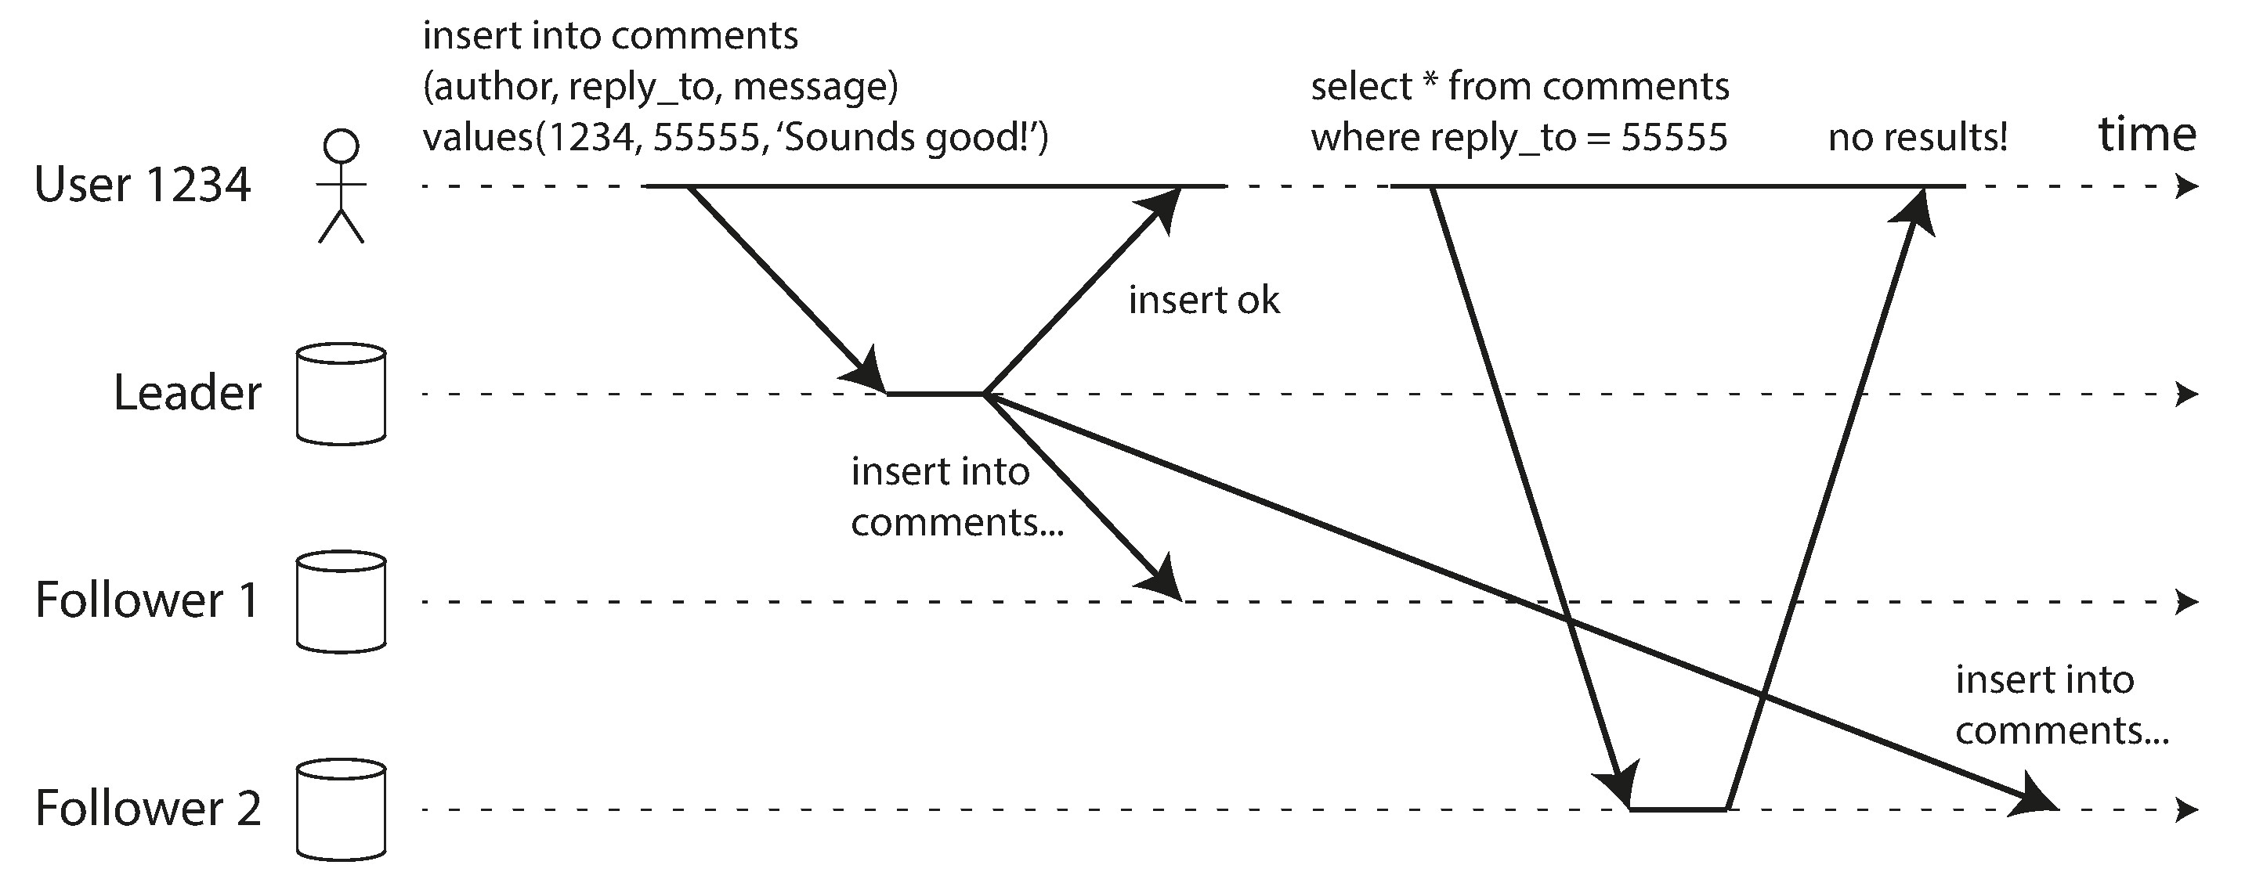
Problems with Replication Lag

Slide 77
Solutions for Replication Lag
Read on leaders
Reading Your Own Writes
Monotonic Reads
They will not read older data after having previously read newer data.
Consistent Prefix Reads
This guarantee says that if a sequence of writes happens in a certain order, then anyone reading those writes will see them appear in the same order
Transaction

Slide 78
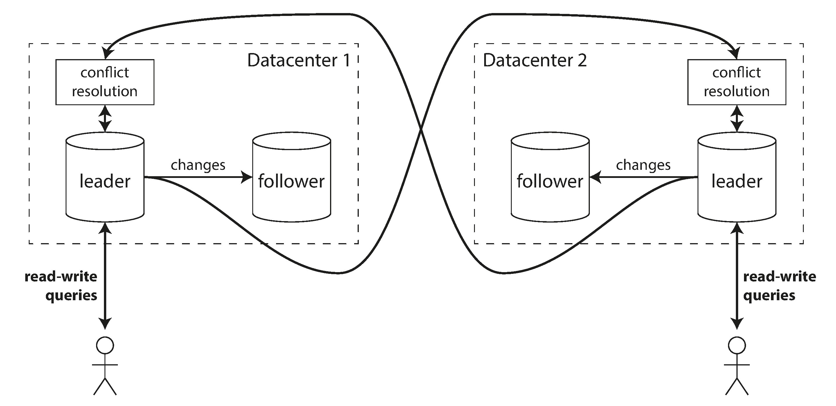
Multi-Leader Replication
Performance
Tolerance of datacenter outages
Tolerance of network problems
Clients with offline operation
Collaborative editing

Slide 79
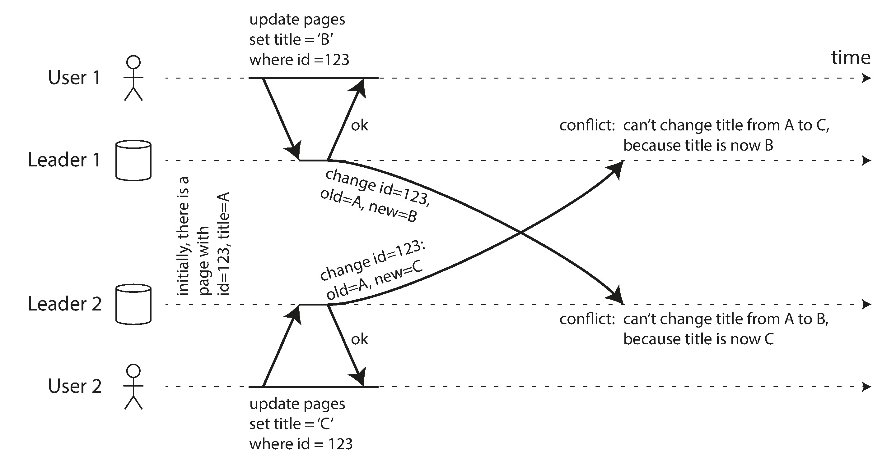
Handling Write Conflicts
Synchronous versus asynchronous conflict detection
Conflict avoidance by writing to same leader
Converging toward a consistent state
Custom conflict resolution logic

Slide 80
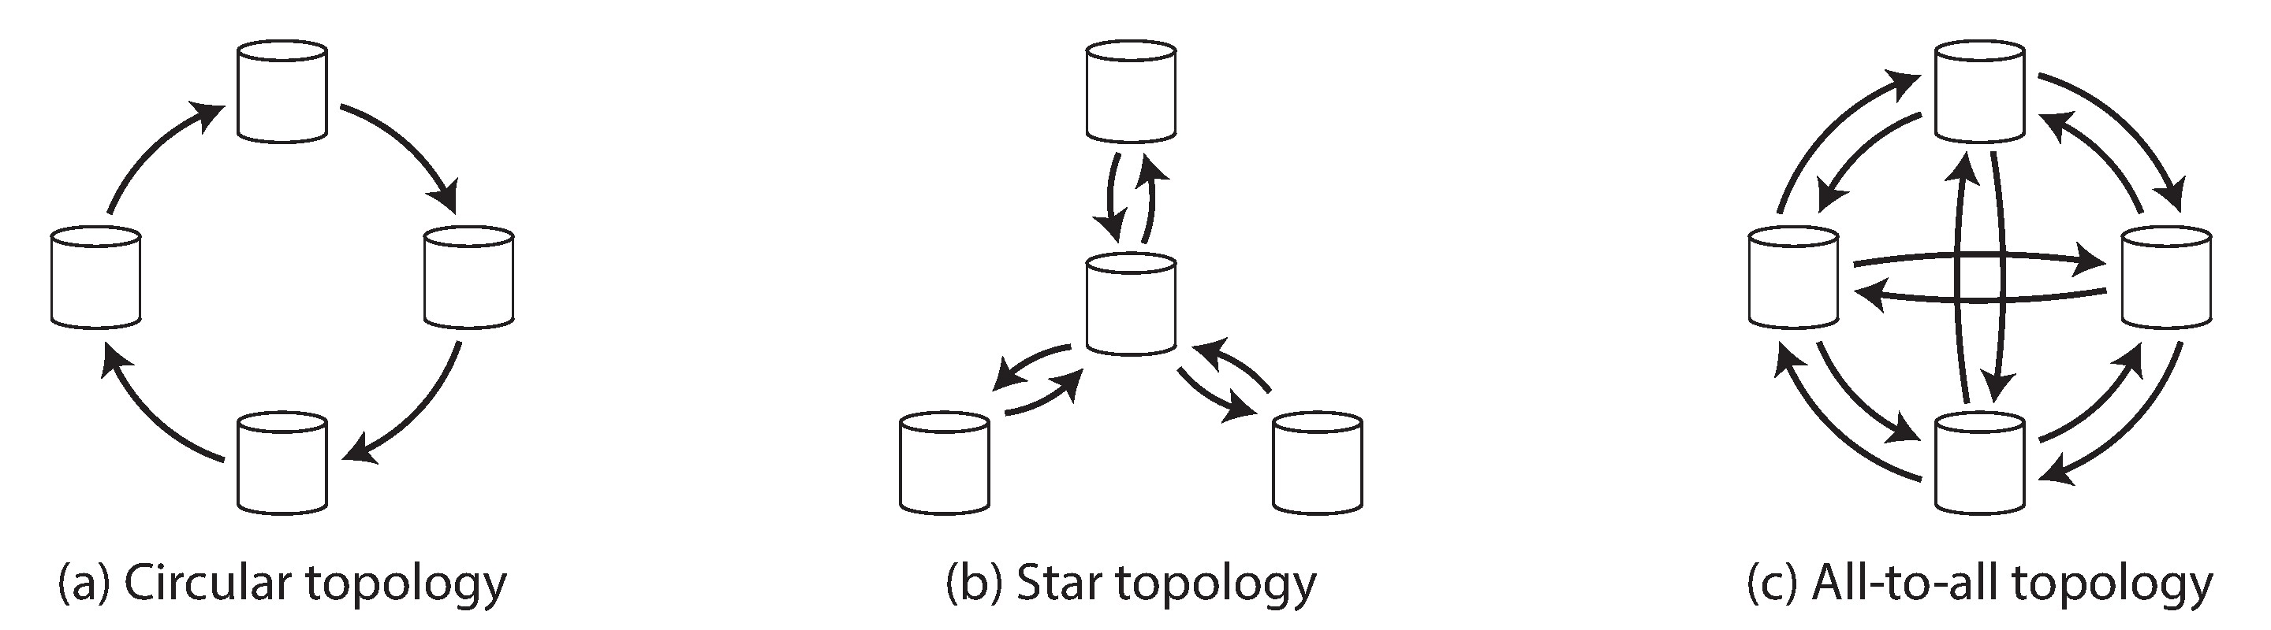
Multi-Leader Replication Topologies
A problem with circular and star topologies is that if just one node fails, it can interrupt the flow of replication messages between other nodes.
On the other hand, all-to-all topologies can have issues too. In particular, some network links may be faster than others (e.g., due to network congestion), with the result that some replication messages may “overtake” others

Slide 81
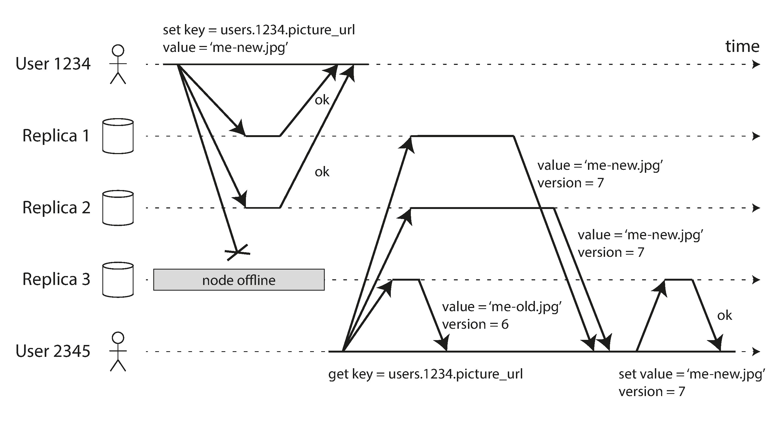
Leaderless Replication
Clients directly writes to and reads from multiple replicas.
Data has the version.

Slide 82
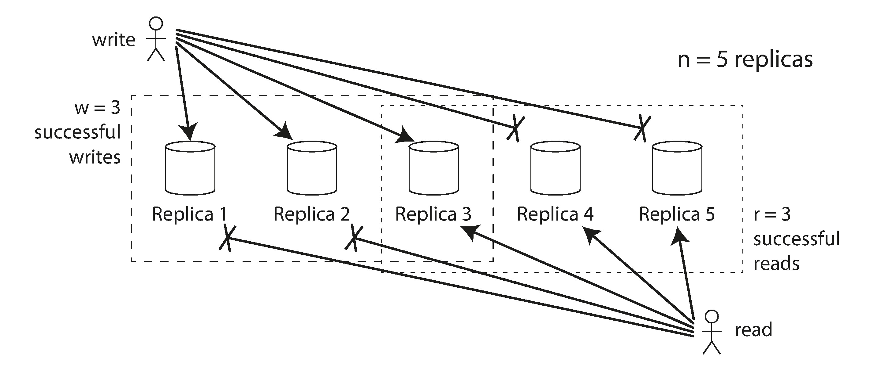
Quorums for reading and writing
R+ W > N means strong consistency.

Slide 83
Other read write strategies
Sloppy Quorums and Hinted Handoff
Write the neighbor nodes instead of the home nodes.
Good for write availability, bad for consistency.
Multi-datacenter operation
May keep the write and read local

Slide 84
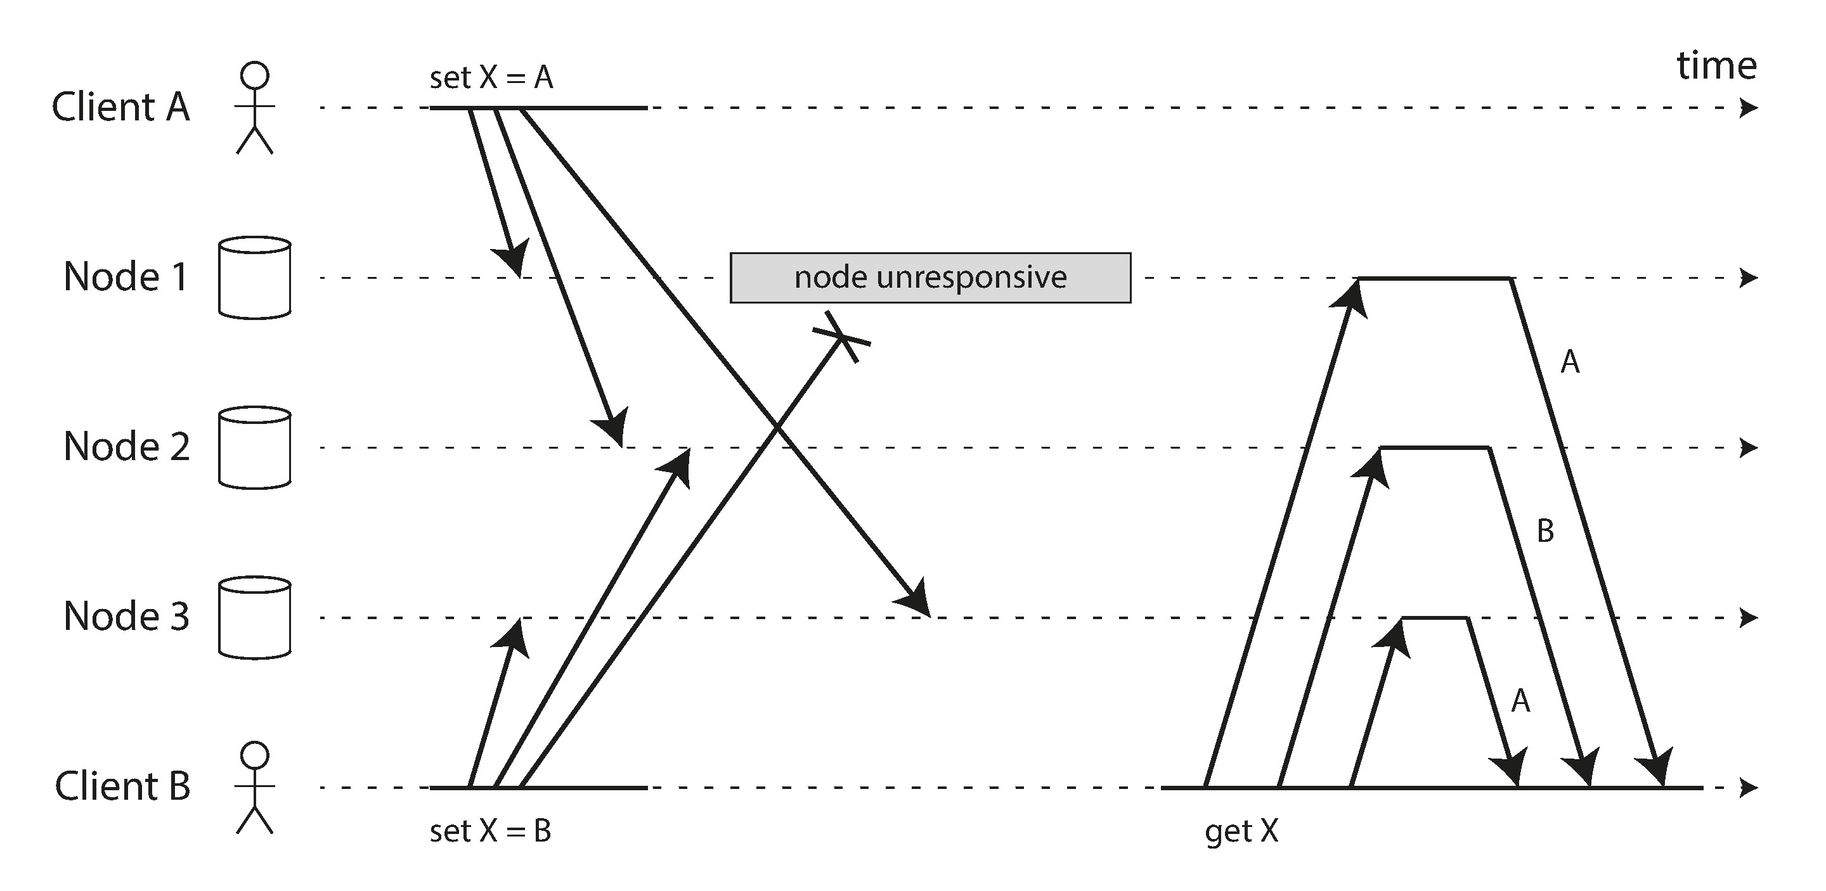
Detecting Concurrent Writes
Last write wins (discarding concurrent writes)
Capturing the happens-before relationship
Merging concurrently written values
Version vectors

Slide 85
Partition

Slide 86
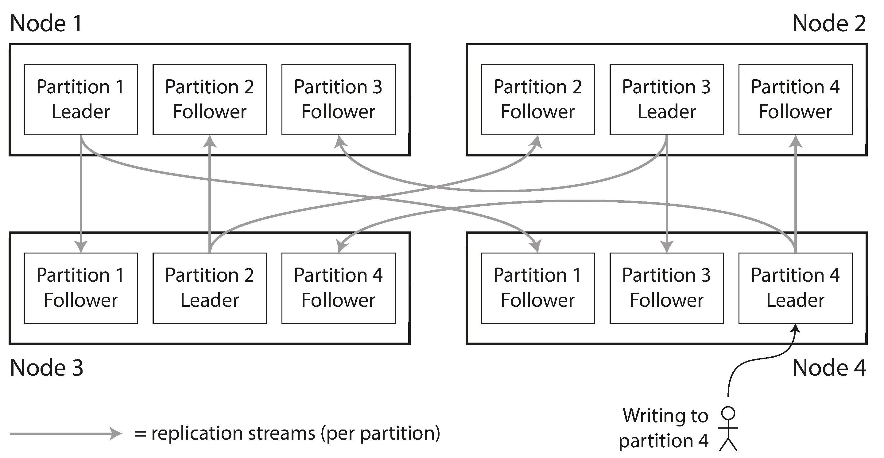
Partitioning and Replication

Slide 87
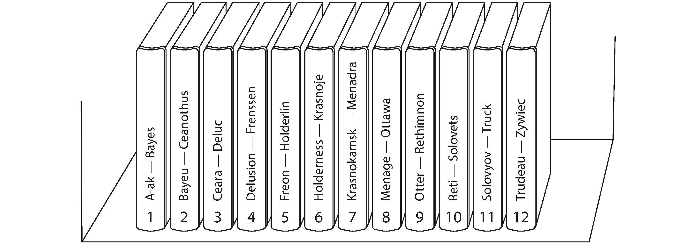
Partitioning by Key Range
Good for range query

Slide 88
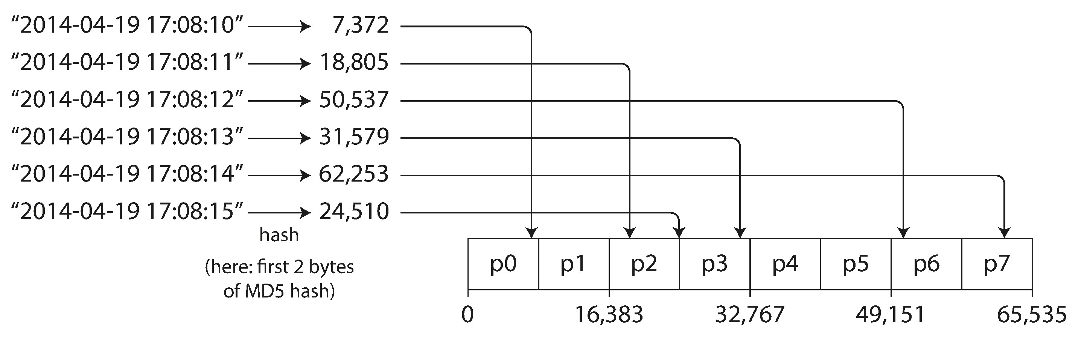
Partitioning by Hash of Key
Distribute evenly

Slide 89
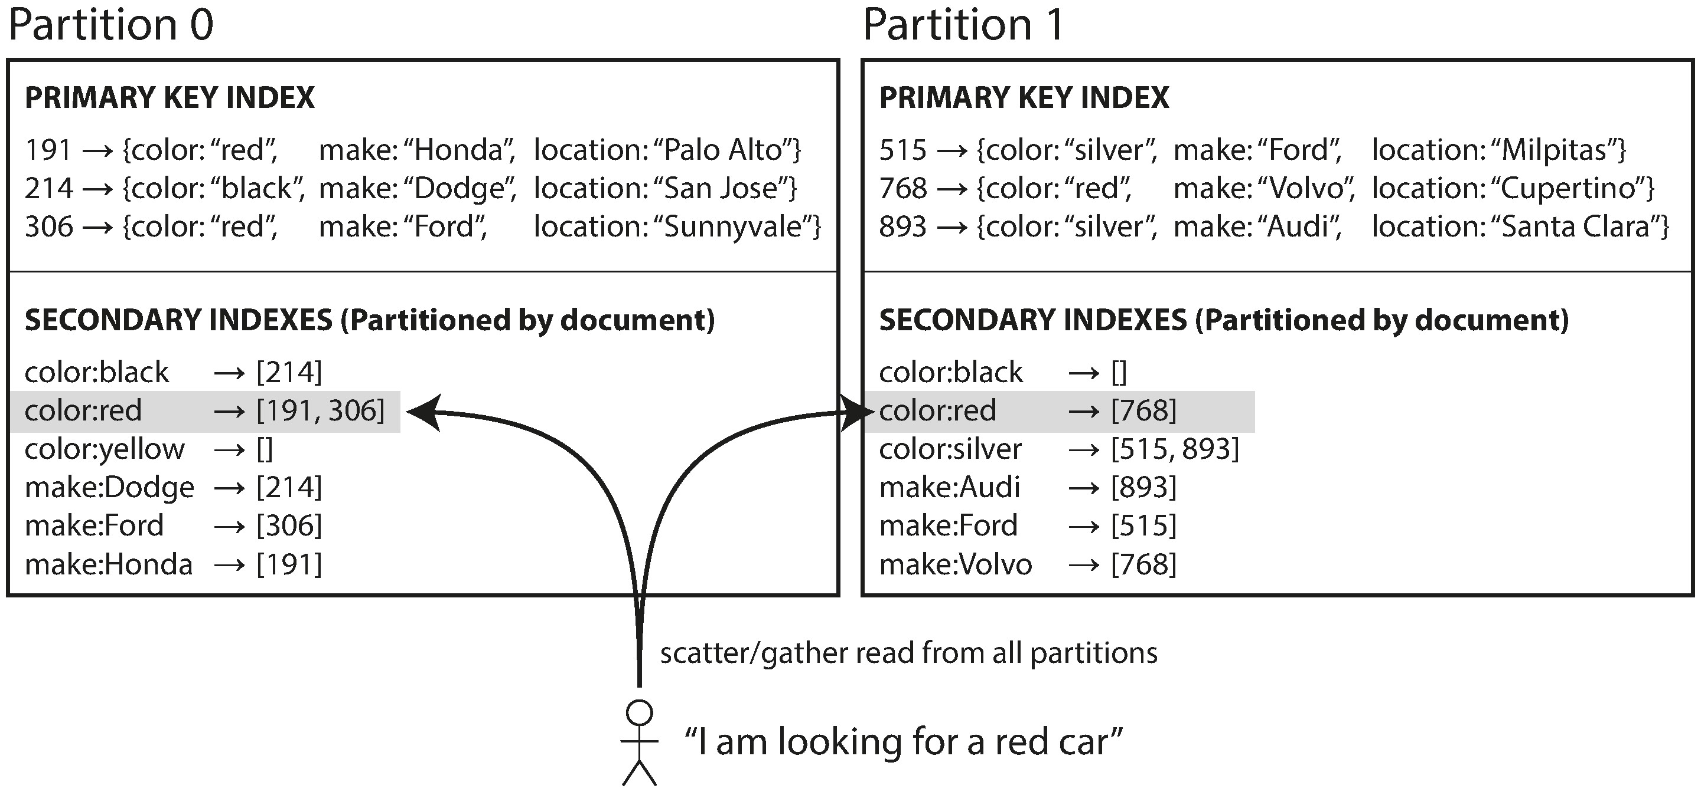
Partitioning Secondary Indexes by Document
Local Index

Slide 90
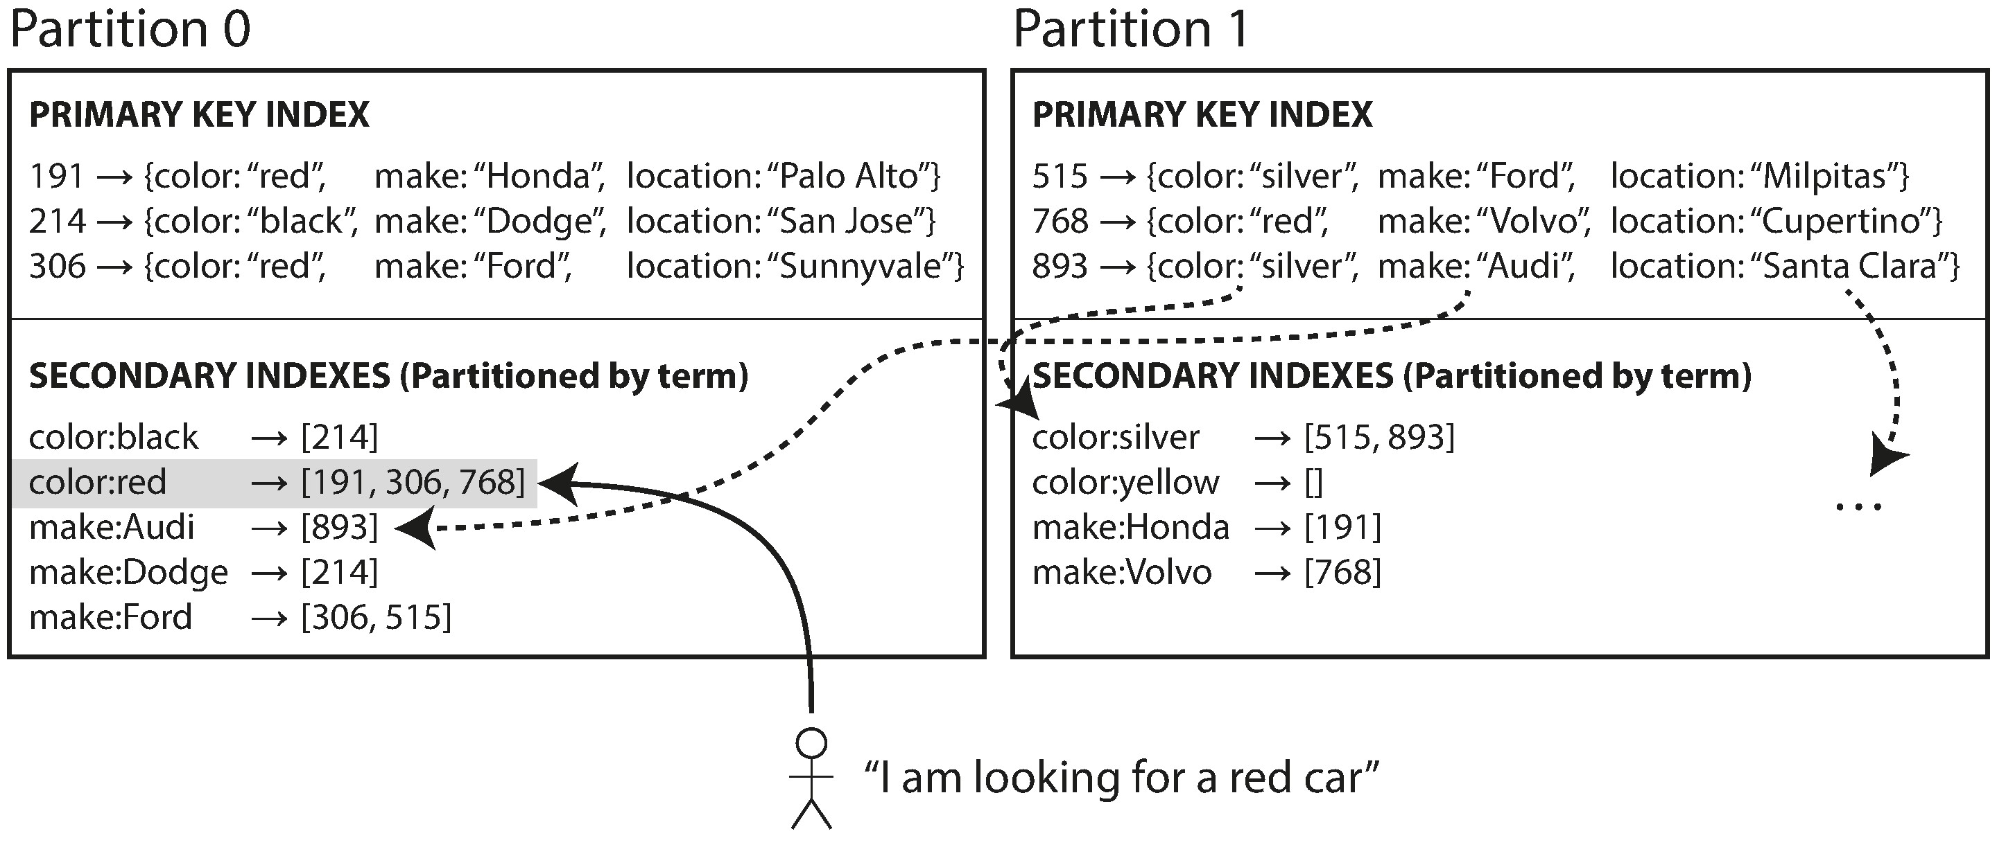
Partitioning Secondary Indexes by Term
Global Index

Slide 91

Rebalancing Partitions
Strategies for Rebalancing
How not to do it: hash mod N
Fixed number of partitions.
Dynamic partitioning
Partitioning proportionally to nodes

Slide 92

Request Routing

Slide 93

Request Routing – Zoo Keeper

Slide 94
Routing in real examples
LinkedIn’s Espresso uses Helix [31] for cluster management (which in turn relies on ZooKeeper).
Cassandra and Riak use a gossip protocol among the nodes to disseminate any changes in cluster state. Requests can be sent to any node, and that node forwards them to the appropriate node for the requested partition.
Couchbase does not rebalance automatically, which simplifies the design. Normally it is configured with a routing tier called moxi, which learns about routing changes from the cluster nodes [32].

Slide 95
Transaction

Slide 96
The Meaning of ACID
Atomicity
atomic refers to something that cannot be broken down into smaller parts.
Consistency
consistency is that you have certain statements about your data (invariants) that must always be true—for example, in an accounting system, credits and debits across all accounts must always be balanced.
Isolation
Several clients are reading or writing the same database records, you can run into concurrency problems (race conditions).
Durability
Durability is the promise that once a transaction has committed successfully, any data it has written will not be forgotten, even if there is a hardware fault or the database crashes

Slide 97
Isolation Levels
Weak Isolation Levels
Read Committed
Repeatable Read
Serialization

Slide 98


Slide 100


Slide 101

Read Commit
No dirty read, no dirty write

Slide 102

Snapshot Isolation and Repeatable Read
Implementing snapshot isolation using multi-version objects.

Slide 103
Snapshot Isolation and Repeatable Read
1. At the start of each transaction, the database makes a list of all the other transactions that are in progress (not yet committed or aborted) at that time. Any writes that those transactions have made are ignored, even if the transactions subsequently commit.
2. Any writes made by aborted transactions are ignored.
3. Any writes made by transactions with a later transaction ID (i.e., which started after the current transaction started) are ignored, regardless of whether those transactions have committed.
4. All other writes are visible to the application’s queries.

Slide 104
Write Conflict
Incrementing a counter or updating an account balance (requires reading the current value, calculating the new value, and writing back the updated value)
Making a local change to a complex value, e.g., adding an element to a list within a JSON document (requires parsing the document, making the change, and writing back the modified document)
Two users editing a wiki page at the same time, where each user saves their changes by sending the entire page contents to the server, overwriting whatever is currently in the database

Slide 105
Preventing Lost Updates
Atomic write operations
UPDATE counters SET value = value + 1 WHERE key = 'foo';
Explicit locking
BEGIN TRANSACTION;
SELECT * FROM figures
WHERE name = 'robot' AND game_id = 222
FOR UPDATE;
Automatically detecting lost updates
When conflict detected retry read-modify-write cycle
Compare-and-set
-- This may or may not be safe, depending on the database implementation
UPDATE wiki_pages SET content = 'new content'
WHERE id = 1234 AND content = 'old content’;
Conflict resolution and replication
Allow conflict version and resolved by application

Slide 106

Write Skew and Phantoms

Slide 107
Code Resolve Phantoms
BEGIN TRANSACTION;
SELECT * FROM doctors
WHERE on_call = true
AND shift_id = 1234 FOR UPDATE;
UPDATE doctors
SET on_call = false
WHERE name = 'Alice’
AND shift_id = 1234;
COMMIT

Slide 108

Encapsulating transactions in stored procedures

Slide 109
Two-Phase Locking (2PL)
Several transactions are allowed to concurrently read the same object as long as nobody is writing to it. But as soon as anyone wants to write (modify or delete) an object, exclusive access is required:
If transaction A has read an object and transaction B wants to write to that object, B must wait until A commits or aborts before it can continue. (This ensures that B can’t change the object unexpectedly behind A’s back.)
If transaction A has written an object and transaction B wants to read that object, B must wait until A commits or aborts before it can continue. (Reading an old version of the object, like in Figure 7-1, is not acceptable under 2PL.)
Clients starts from a shared lock, when it is going to write, it tries to acquire a exclusive lock
Predicate locks
Dead locks
Index-range locks
Notes:
If a transaction wants to read an object, it must first acquire the lock in shared mode. Several transactions are allowed to hold the lock in shared mode simultaneously, but if another transaction already has an exclusive lock on the object, these transactions must wait.
If a transaction wants to write to an object, it must first acquire the lock in exclusive mode. No other transaction may hold the lock at the same time (either in shared or in exclusive mode), so if there is any existing lock on the object, the transaction must wait.
If a transaction first reads and then writes an object, it may upgrade its shared lock to an exclusive lock. The upgrade works the same as getting an exclusive lock directly.
After a transaction has acquired the lock, it must continue to hold the lock until the end of the transaction (commit or abort). This is where the name “twophase” comes from: the first phase (while the transaction is executing) is when the locks are acquired, and the second phase (at the end of the transaction) is when all the locks are released.

Slide 110

Optimistic concurrency control
Detecting stale MVCC reads
Notes:
If a transaction wants to read an object, it must first acquire the lock in shared mode. Several transactions are allowed to hold the lock in shared mode simultaneously, but if another transaction already has an exclusive lock on the object, these transactions must wait.
If a transaction wants to write to an object, it must first acquire the lock in exclusive mode. No other transaction may hold the lock at the same time (either in shared or in exclusive mode), so if there is any existing lock on the object, the transaction must wait.
If a transaction first reads and then writes an object, it may upgrade its shared lock to an exclusive lock. The upgrade works the same as getting an exclusive lock directly.
After a transaction has acquired the lock, it must continue to hold the lock until the end of the transaction (commit or abort). This is where the name “twophase” comes from: the first phase (while the transaction is executing) is when the locks are acquired, and the second phase (at the end of the transaction) is when all the locks are released.

Slide 111

Serializable Snapshot Isolation
Detecting writes that affect prior reads
Notes:
If a transaction wants to read an object, it must first acquire the lock in shared mode. Several transactions are allowed to hold the lock in shared mode simultaneously, but if another transaction already has an exclusive lock on the object, these transactions must wait.
If a transaction wants to write to an object, it must first acquire the lock in exclusive mode. No other transaction may hold the lock at the same time (either in shared or in exclusive mode), so if there is any existing lock on the object, the transaction must wait.
If a transaction first reads and then writes an object, it may upgrade its shared lock to an exclusive lock. The upgrade works the same as getting an exclusive lock directly.
After a transaction has acquired the lock, it must continue to hold the lock until the end of the transaction (commit or abort). This is where the name “twophase” comes from: the first phase (while the transaction is executing) is when the locks are acquired, and the second phase (at the end of the transaction) is when all the locks are released.

Slide 112
Pessimistic versus optimistic concurrency control
If high concurrency, use 2PL, otherwise use optimistic solution
Notes:
If a transaction wants to read an object, it must first acquire the lock in shared mode. Several transactions are allowed to hold the lock in shared mode simultaneously, but if another transaction already has an exclusive lock on the object, these transactions must wait.
If a transaction wants to write to an object, it must first acquire the lock in exclusive mode. No other transaction may hold the lock at the same time (either in shared or in exclusive mode), so if there is any existing lock on the object, the transaction must wait.
If a transaction first reads and then writes an object, it may upgrade its shared lock to an exclusive lock. The upgrade works the same as getting an exclusive lock directly.
After a transaction has acquired the lock, it must continue to hold the lock until the end of the transaction (commit or abort). This is where the name “twophase” comes from: the first phase (while the transaction is executing) is when the locks are acquired, and the second phase (at the end of the transaction) is when all the locks are released.

Slide 113
The Trouble with Distributed Systems

Slide 114
Anything may go wrong
Faults and Partial Failure
In Cloud some components, software or hardware goes wrong but others may still work. This partial failure may give us nondeterministic result. It is hard to determine success or failure.
Cloud Computing and Supercomputing
For super computing when something goes wrong you stop it and give up all intermediate result and restart the system. For cloud computing, when things go wrong you should still make it run and keep availability.
Super computer is built on expensive hardware with redundancy while cloud computing is built on commodity computer with distributed replicas.
In cloud computing, we will have some nodes unavailability even nothing goes wrong, for example, deployment.

Slide 115

Unreliable Networks
1. Your request may have been lost (perhaps someone unplugged a network cable).
2. Your request may be waiting in a queue and will be delivered later (perhaps the network or the recipient is overloaded).
3. The remote node may have failed (perhaps it crashed or it was powered down).
4. The remote node may have temporarily stopped responding (perhaps it is experiencing a long garbage collection pause; see “Process Pauses” on page 295), but it will start responding again later.
5. The remote node may have processed your request, but the response has been lost on the network (perhaps a network switch has been misconfigured).
6. The remote node may have processed your request, but the response has been delayed and will be delivered later (perhaps the network or your own machine is overloaded).
The sender has no way to know the network error except for that it did not get response.

Slide 116

Timeouts and Unbounded Delays
There is no guarantee that a maximum timeout can be safely determined in a cloud environment, but the timeout may be the only way we know something is wrong.
Network congestion and queueing

Slide 117
Unreliable Clocks
Time-of-day clocks
It returns the current date and time according to some calendar (also known as wall-clock time). For exam‐ple, clock_gettime(CLOCK_REALTIME) on Linuxv and System.currentTimeMillis() in Java return the number of seconds (or milliseconds) since the epoch: midnight UTC on January 1, 1970, not counting leap seconds.
Monotonic clocks
A monotonic clock is guaranteed to always move forward (whereas a time-ofday clock may jump back in time): clock_gettime(CLOCK_MONOTONIC) on Linux and System.nanoTime() in Java are monotonic clocks.
Clock Synchronization and Accuracy
Monotonic clocks don’t need synchronization, but time-of-day clocks need to be set according to an NTP server or other external time source

Slide 118

Timestamps for ordering events

Slide 119
Clock readings have a confidence interval
Google’s TrueTime API in Spanner [41], which explicitly reports the confidence interval on the local clock. When you ask it for the current time, you get back two values: [earliest, latest], which are the earliest possible and the latest possible timestamp.
Spanner implements snapshot isolation across datacenters in this way [59, 60]. It uses the clock’s confidence interval as reported by the TrueTime API, and is based on the following observation: if you have two confidence intervals, each consisting of an earliest and latest possible timestamp (A = [A_{earliest}, A_{latest}] and B = [B_{earliest}, B_{latest}]), and those two intervals do not overlap (i.e., A_{earliest} < A_{latest} < B_{earliest} < B_{latest}), then B definitely happened after A—there can be no doubt. Only if the intervals overlap are we unsure in which order A and B happened.

Slide 120
Process Pauses
• Many programming language runtimes (such as the Java Virtual Machine) have a garbage collector (GC) that occasionally needs to stop all running threads. These “stop-the-world” GC pauses have sometimes been known to last for several minutes
• If the application performs synchronous disk access, a thread may be paused waiting for a slow disk I/O operation to complete
• If the operating system is configured to allow swapping to disk (paging), a simple memory access may result in a page fault that requires a page from disk to be loaded into memory.
Response time guarantees?
May be not possible.

Slide 121


The leader lock and fencing token

Slide 122
System Model and Reality
Synchronous mode
The synchronous model assumes bounded network delay, bounded process pauses, and bounded clock error.
Partially synchronous model
Partial synchrony means that a system behaves like a synchronous system most of the time, but it sometimes exceeds the bounds for network delay, process pauses, and clock drift.
Asynchronous model
In this model, an algorithm is not allowed to make any timing assumptions—in fact, it does not even have a clock.
Crash-stop faults
The node crash and never come back.
Crash-recovery faults
The nodes may crash at any moment, and perhaps start responding again after some unknown time.
Byzantine (arbitrary) faults
Nodes may do absolutely anything, including trying to trick and deceive other nodes, as described in the last section.

Slide 123
Consistency and Consensus

Slide 124

Linearizability Violation

Slide 125

Linearizability
The basic idea behind linearizability is simple: to make a system appear as if there is only a single copy of the data.
In a linearizable system we imagine that there must be some point in time (between the start and end of the write operation) at which the value of x atomically flips from 0 to 1. Thus, if one client’s read returns the new value 1, all subsequent reads must also return the new value, even if the write operation has not yet completed.

Slide 126
Linearizability Versus Serializability
Serializability
Serializability is an isolation property of transactions, where every transaction may read and write multiple objects (rows, documents, records)—see “SingleObject and Multi-Object Operations” on page 228. It guarantees that transactions behave the same as if they had executed in some serial order (each transaction running to completion before the next transaction starts). It is okay for that serial order to be different from the order in which transactions were actually run.
Linearizability
Linearizability is a recency guarantee on reads and writes of a register (an individual object). It doesn’t group operations together into transactions, so it does not prevent problems such as write skew (see “Write Skew and Phantoms” on page 246), unless you take additional measures such as materializing conflicts (see “Materializing conflicts” on page 251).

Slide 127
Linearizability Versus Serializability
Serializability
Serializability is an isolation property of transactions, where every transaction may read and write multiple objects (rows, documents, records)—see “SingleObject and Multi-Object Operations” on page 228. It guarantees that transactions behave the same as if they had executed in some serial order (each transaction running to completion before the next transaction starts). It is okay for that serial order to be different from the order in which transactions were actually run.
Linearizability
Linearizability is a recency guarantee on reads and writes of a register (an individual object). It doesn’t group operations together into transactions, so it does not prevent problems such as write skew (see “Write Skew and Phantoms” on page 246), unless you take additional measures such as materializing conflicts (see “Materializing conflicts” on page 251).

Slide 128

Relying on Linearizability
Locking and leader election
Coordination services like Apache ZooKeeper [15] and etcd [16] are often used to implement distributed locks and leader election. They use consensus algorithms to implement linearizable operations in a fault-tolerant way
Constraints and uniqueness guarantees
Uniqueness constraints are common in databases: for example, a username or email address must uniquely identify one user, and in a file storage service there cannot be two files with the same path and filename. If you want to enforce this constraint as the data is written (such that if two people try to concurrently create a user or a file with the same name, one of them will be returned an error), you need linearizability.
Cross-channel timing dependencies

Slide 129

Implementing Linearizable Systems
Single-leader replication (potentially linearizable)
Consensus algorithms (linearizable)
Multi-leader replication (not linearizable)
Leaderless replication (probably not linearizable，even with quorum)

Slide 130
Read Repair to make it Linearizable
Interestingly, it is possible to make Dynamo-style quorums linearizable at the cost of reduced performance: a reader must perform read repair (see “Read repair and antientropy” on page 178) synchronously, before returning results to the application [23], and a writer must read the latest state of a quorum of nodes before sending its writes [24, 25].
Riak does not perform synchronous read repair due to the performance penalty [26].
Cassandra does wait for read repair to complete on quorum reads [27], but it loses linearizability if there are multiple concurrent writes to the same key, due to its use of last-write-wins conflict resolution.
The cost of linearizability is always availability and performance.

Slide 131
Ordering and Causality
Linearizability
In a linearizable system, we have a total order of operations: if the system behaves as if there is only a single copy of the data, and every operation is atomic, this means that for any two operations we can always say which one happened first. This total ordering is illustrated as a timeline in Figure 9-4.
Causality
We said that two operations are concurrent if neither happened before the other (see “The “happens-before” relationship and concurrency” on page 186). Put another way, two events are ordered if they are causally related (one happened before the other), but they are incomparable if they are concurrent. This means that causality defines a partial order, not a total order: some operations are ordered with respect to each other, but some are incomparable.
Linearizability is stronger than causal consistency

Slide 132

Sequence Number Ordering
Lamport timestamps
A Lamport timestamp bears no relationship to a physical time-of-day clock, but it provides total ordering: if you have two timestamps, the one with a greater counter value is the greater timestamp; if the counter values are the same, the one with the greater node ID is the greater timestamp.

Slide 133
Total Order Broadcast
Total order broadcast is usually described as a protocol for exchanging messages between nodes. Informally, it requires that two safety properties always be satisfied:
Reliable delivery
No messages are lost: if a message is delivered to one node, it is delivered to all nodes.
Totally ordered delivery
Messages are delivered to every node in the same order.

Slide 134
Implementing linearizable storage using total order broadcast
Append a message to the log, tentatively indicating the username you want to claim.
Read the log, and wait for the message you appended to be delivered back to you.^{xi}
Check for any messages claiming the username that you want. If the first message for your desired username is your own message, then you are successful: you can commit the username claim (perhaps by appending another message to the log) and acknowledge it to the client. If the first message for your desired username is from another user, you abort the operation.

Slide 135

Distributed Transactions and Consensus
Atomic Commit and Two-Phase Commit (2PC)

Slide 136
Two-Phase Commit (2PC)
Thus, the protocol contains two crucial “points of no return”: when a participant votes “yes,” it promises that it will definitely be able to commit later (although the coordinator may still choose to abort); and once the coordinator decides, that decision is irrevocable. Those promises ensure the atomicity of 2PC.

Slide 137

Coordinator failure
Three Phase Commit
3PC assumes a network with bounded delay and nodes with bounded response times; in most practical systems with unbounded network delay and process pauses (see Chapter 8), it cannot guarantee atomicity

Slide 138
Distributed Transactions in Practice
Database-internal distributed transactions
Heterogeneous distributed transactions
Exactly-once message processing
XA transactions
X/Open XA (short for eXtended Architecture) is a standard for implementing twophase commit across heterogeneous technologies [76, 77]. It was introduced in 1991 and has been widely implemented: XA is supported by many traditional relational databases (including PostgreSQL, MySQL, DB2, SQL Server, and Oracle) and message brokers (including ActiveMQ, HornetQ, MSMQ, and IBM MQ).

Slide 139
Fault-Tolerant Consensus
Uniform agreement
No two nodes decide differently.
Integrity
No node decides twice.
Validity
If a node decides value v, then v was proposed by some node.
Termination
Every node that does not crash eventually decides some value.

Slide 140

PAXOS

